Slide 1
Your Guide to
ALLERGIES
ASTHMA
COPD

Slide 2
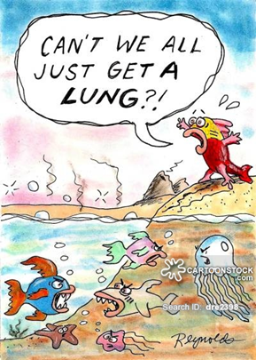
Breathing is something we all need to do in order to survive - and thrive.
ALLERGIES
ASTHMA
COPD -
Chronic Obstructive Pulmonary Disease
…can make something as basic as breathing,
a challenge.

Slide 3
Allergies
Blame Your Immune System
It is overreacting to an allergen which the body views as a foreign invader that must be stopped.
To fight the invader, the body produces Immunoglobulin E antibodies.
These antibodies travel to cells that release histamine and other chemicals, causing an allergic reaction.
Notes:
In the US, over 50 million people have allergies.
An allergic reaction typically triggers symptoms in the nose, lungs, throat, sinuses, ears, lining of the stomach or on the skin. For some people, allergies can also trigger symptoms of asthma. In the most serious cases, a life-threatening reaction called anaphylaxis (an-a-fi-LAK-sis) can occur.
Irritants that contribute to allergy issues are very similar to things that make asthma worse.

Slide 4
Pollen counts are highest in the morning.
Notes:
A number of different allergens are responsible for allergic reactions. The most common include:
• Pollen
• Dust
• Food
• Insect stings
• Animal dander
• Mold
• Medications
• Latex
Source: http://www.aaaai.org/conditions-and-treatments/allergies.aspx

Slide 5
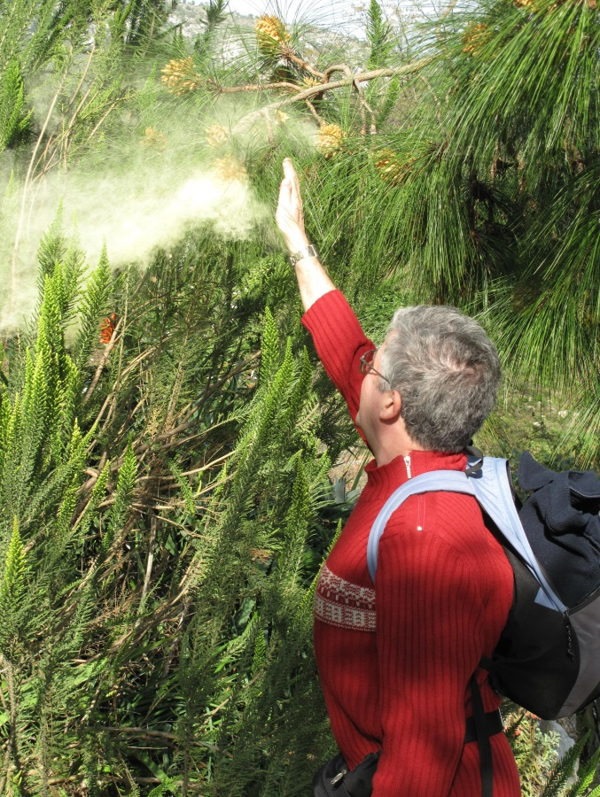
Seasonal Allergies
Spring
Summer
Fall
Trees
Grass
Weeds
Notes:
What Causes Springtime Allergies?
Spring allergies are a result of pollen from trees, which can start pollinating anytime from January to April, depending on the climate and location. Trees that are known to cause severe allergies include oak, olive, elm, birch, ash, hickory, poplar, sycamore, maple, cypress, and walnut. In some areas of the world, some weeds will also pollinate in the springtime.
What Causes Summertime Allergies?
Grass pollen is typically the main cause of late spring and early summer allergies. Grass pollen is highest at these times. However, grass may cause allergies through much of the year if someone is mowing the lawn or lying in the grass. Contact with grass can result in itching and hives in people who are allergic to grass pollen, this is called contact urticaria.
Grasses can be divided into two major classes, northern and southern grasses. Northern grasses are common in colder climates, and include timothy, rye, orchard, sweet vernal, red top, and blue grasses. Southern grasses are present in warmer climates, with Bermuda grass being the major grass in this category.
What Causes Fall Allergies?
Weed pollen is the main cause of seasonal allergy in the late summer and early fall. Depending on the area of North America, these weeds include ragweed, sagebrush, pigweed, tumbleweed (Russian thistle), and cocklebur. In some areas of the world, some trees can pollinate in the fall as well.
http://www.weather.com/activities/health/allergies/helpclinic/help_allergy_pollen.html

Slide 6
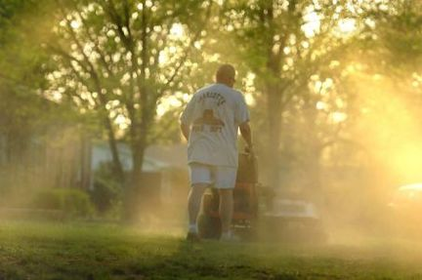
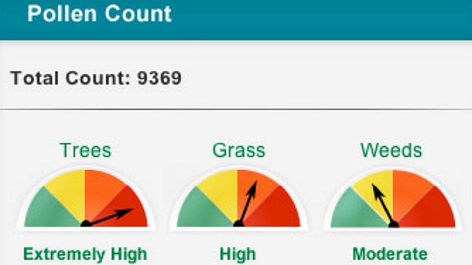
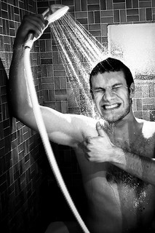
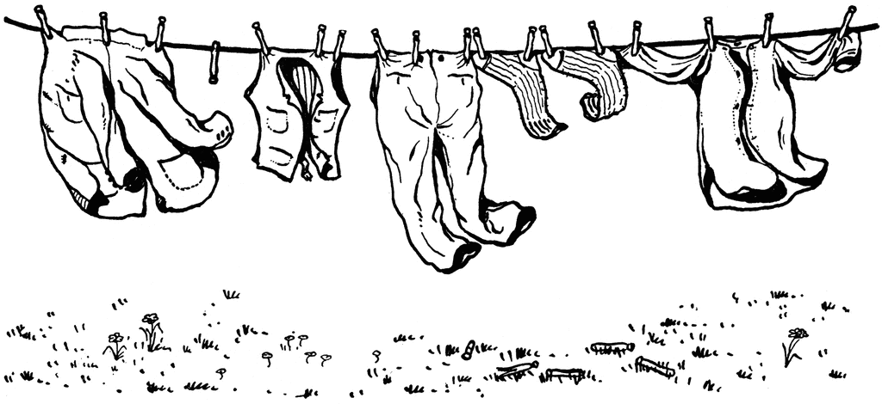
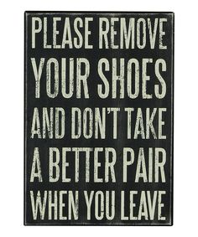
HOW TO PREVENT/DIMINISH ALLERGY SYMPTOMS
Know before you go!
Dust mask & goggles can help
Shoes & coats off at the door
No clothes-lines
Notes:
Pay attention to the pollen count and plan accordingly.
Wear a dust mask and goggles while doing yard work, especially in the morning, to reduce the impacts of airborne pollen.
Shower before bed or after extended time outdoors to rinse away pollen.
Do not hang clothes on the line.
Take coats and shoes off…reduces ??% of dust and dirt in home.

Slide 7
Allergens in the home
1. Kick Dust Mites Out of Bed
2. Vacuum Regularly
3. Use Light Window Treatments
4. De-clutter Your Home
5. Protect Your Air
Notes:
1. Bedding is a popular home for dust mites, a common trigger of allergies and asthma. Wash your bedding every week in water that is at least 130 F. Dry it in a hot dryer. This includes couch throws and blankets.
2. Carpeting is another happy habitat for dust mites. Choose hard wood or low-nap carpet.
3. Wipe window frames and glass to prevent mold and mildew. Wash curtains regularly.
4. The less upholstery in the room, the better. Clutter encourages dust. Don’t store things under your bed.
5. Dust mites and mold like a warm, damp bedroom. Use your air conditioner. Dust mites don’t reproduce well when it’s below 77 F.
6. Restricting a pet from the bedroom can be hard, but dander, saliva, and urine from pets with fur can carry allergens. Ideally, your pet should sleep elsewhere.

Slide 8
Make your bedroom a PET FREE ZONE
Fido and Fluffy can make bad allergies worse
Give pets
their own space in another room
Notes:
Restricting a pet from the bedroom can be hard (especially if they know how to open doors like these two!), but dander, saliva, and urine from pets with fur can carry allergens. Ideally, your pet should sleep elsewhere.

Slide 9
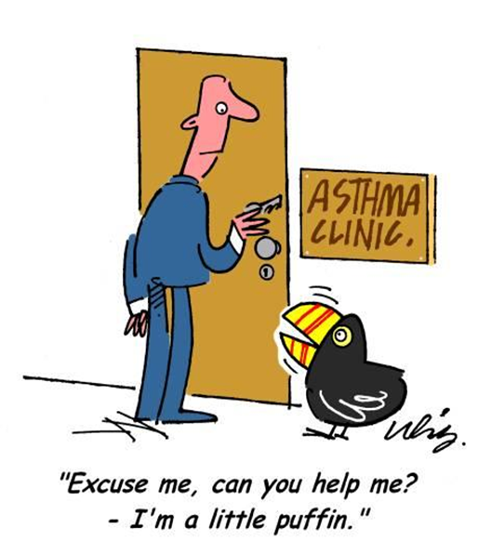
Which is it?

Slide 10
Cold or Allergies?
Characteristic | Cold | Allergy
Duration | 3-14 days | Days to months -- as long as you are exposed to the allergen
Time of Year | Most often in the winter, but possible at any time | Any time of the year -- although the appearance of some allergens are seasonal
Onset of symptoms | Symptoms take a few days to appear after infection with the virus | Symptoms can begin immediately after exposure to the allergen
Symptom | Cold | Allergy
Cough | Often | Sometimes
Aches | Sometimes | Never
Fatigue | Sometimes | Sometimes
Fever | Rarely | Never
Itchy, watery eyes | Rarely | Often
Sore throat | Often | Sometimes
Runny or stuffy nose | Often | Often
Notes:
How can you tell if it is an allergy or a cold?

Slide 11
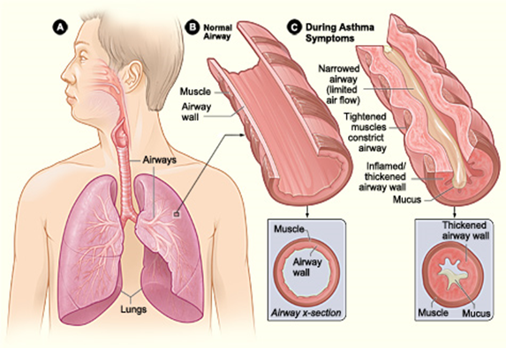
ASTHMA
Asthma is a chronic (long term) lung disease that causes inflammation and narrows the airways making it difficult to breathe.

Slide 12
Asthma affects people of all ages and most often starts in childhood. We don’t know the exact cause of asthma, but research shows it is a combination of genetics and exposure to certain environmental triggers.
Notes:
You can’t prevent asthma, however, you can take steps to control it and prevent its symptoms.
Learn about your asthma and ways to control it.
Follow your written asthma action plan.
Use medicines as your doctor prescribes.
Identify and try to avoid things that make your asthma worse (asthma triggers).
Keep track of your asthma symptoms and level of control.
Get regular checkups for your asthma.

Slide 13
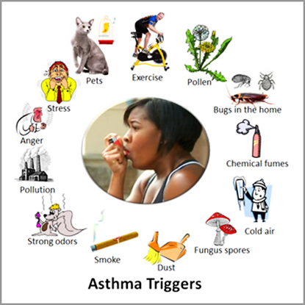
Notes:
MEDICAL CONDITIONS- Respiratory infections, such as a cold, flu, or sinus infection, can lead to an asthma flare-up. Frequent hand washing and avoiding people who are sick will help to reduce your exposure to cold and flu. (Flu shots are recommended for individuals who have asthma.) Other conditions such as acid reflux and pregnancy can also worsen asthma symptoms.
FOOD & MEDICINES – Common triggers are peanuts, shellfish, aspirin and NSAIDS. Be sure to discuss over the counter and herbal supplements you may use with your health care provider.
SMOKE - All types of smoke can make it hard to breathe – including smoke from cigarettes, wood burning fireplaces or burning leaves.
WEATHER, POLLEN and POLLUTION - Changes in the season can bring on an asthma episode due to increased pollen in the air. Limit your time outdoors during high pollen times such as spring and fall. Also, extreme temperatures (hot and cold) can trigger symptoms. Be prepared for the weather before you leave your home by checking the pollen count and air quality index.
ANIMALS - Dander and saliva from animals with fur or feathers. Reduce your exposure by vacuuming and damp dusting weekly. Try to keep your pets out of the bedroom.
PESTS - Dust mites, cockroaches and rodents. To reduce your exposure to these triggers, wash bedding regularly, fix leaks, store garbage outside, vacuum and dust weekly, and use allergen-proof pillow and mattress covers.
MOLD- You can reduce your exposure by cleaning visible mold, throwing away moldy items, running a dehumidifier and using the exhaust fan when showering.
EXERCISE - Staying active is very important to your overall health. If you have exercise induced asthma symptoms, talk with your doctor about medicines that can help you stay active.
EMOTIONS - Strong emotions can increase rapid breathing and trigger asthma symptoms. Stress can be a trigger as well as anger, fear and yelling.
STRONG ODORS - Perfumes, deodorants, and other personal care products as well as candles and cleaning supplies.

Slide 14
ASTHMA SYMPTOMS - symptoms are mild and go away on their own or after minimal treatment with asthma medicine.
Wheezing
Tightness in your chest
Shortness of Breath
Coughing
ASTHMA ATTACK - very serious (can be fatal) and may require emergency care.
Treat asthma symptoms to prevent them from getting worse and causing a life threatening asthma attack.
Notes:
Wheezing - a whistling or squeaky sound that occurs when you breathe.
Tightness in your chest- this may feel like something is squeezing or sitting on your chest.
Shortness of breath – feel like you can't catch their breath or they feel out of breath. You may feel like you can't get air out of your lungs.
Coughing-coughing from asthma often is worse at night or early in the morning, making it hard to sleep.

Slide 15
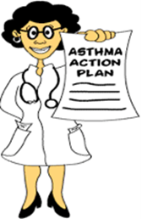
Have an Asthma Action plan
KNOW WHEN TO SEEK EMERGENCY MEDICAL CARE
USE MEDICATIONS CORRECTLY
TRACK SYMPTOMS
REGULAR CHECK UPS
Notes:
KNOW WHEN TO SEEK EMERGENCY MEDICAL CARE - Most people who have asthma can successfully manage their symptoms by following their asthma action plans and having regular checkups. However, knowing when to seek emergency medical care is important.
USE MEDICATIONS CORRECTLY - If you take inhaled medicines, you should practice using your inhaler at your doctor's office. If you take long-term control medicines, take them daily as your doctor prescribes.
TRACK YOUR SYMPTOMS - Record your asthma symptoms as a way to track how well your asthma is controlled. Also, your doctor may advise you to use a peak flow meter a hand-held device that shows how well air moves out of your lungs. You blow into the device and it gives you a score, or peak flow number. Your score shows how well your lungs are working at the time of the test. Your doctor may ask you to keep records of your symptoms and peak flow results daily for a couple of weeks before an office visit. These steps will help you keep track of how well you are controlling your asthma over time. This will help you spot problems early and prevent or relieve asthma attacks. Recording your symptoms and peak flow results to share with your doctor also will help him or her decide whether to adjust your treatment.

Slide 16
Notes:
From NHLBI

Slide 17
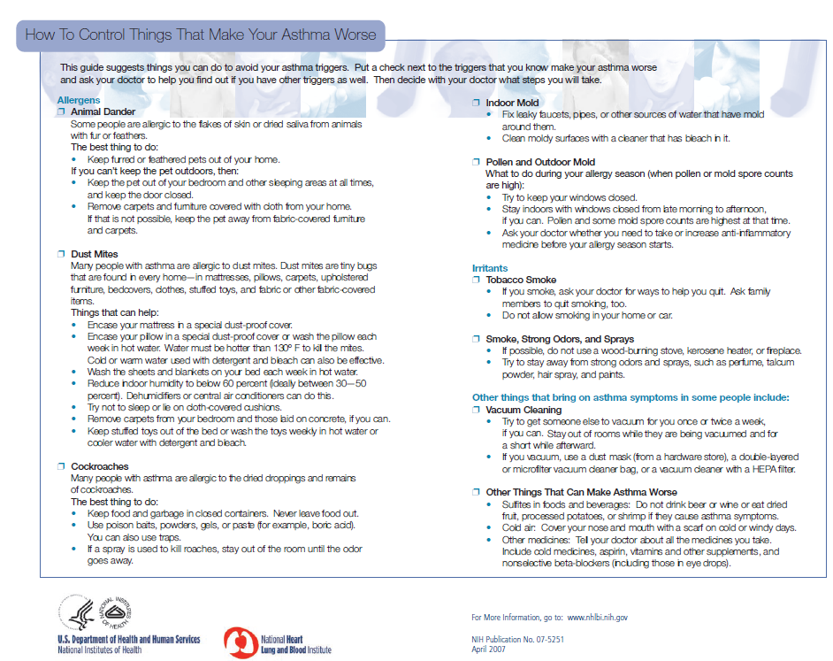

Slide 18
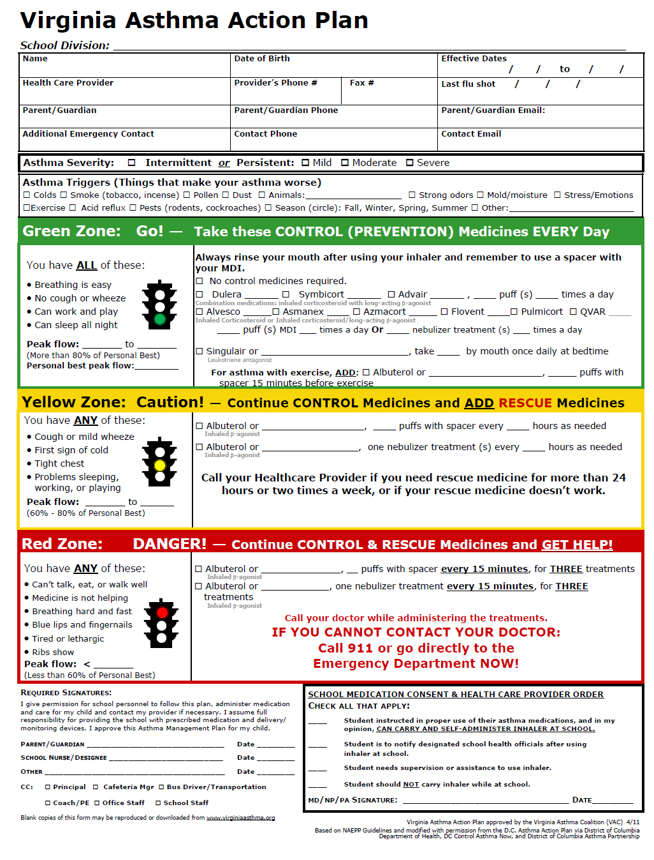
Notes:
http://www.virginiaasthmacoalition.org/documents/VACAAP4-19-2012[1].pdf

Slide 19
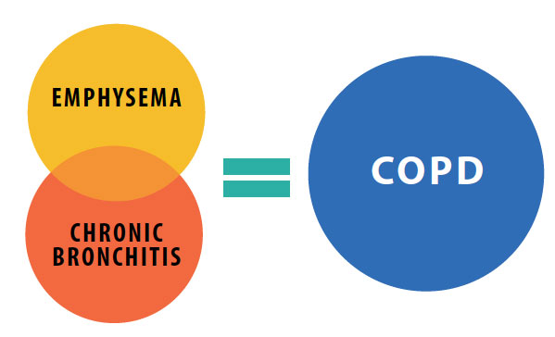
Chronic Obstructive Pulmonary Disease
COPD is a lung disease that, over time, makes it hard to breathe.
COPD means that the flow of air in and out of the lungs is less than it should be. When that happens less oxygen gets into the body tissues and it becomes harder to get rid of carbon dioxide. As the disease gets worse, it is harder to remain active due to shortness of breath.
Most importantly, COPD can be prevented and
can be treated.
Notes:
It causes serious long-term disability and early death. At this time there is no cure for COPD.
More than 12 million people are known to have COPD and up to 24 million may have the disease due to some not even knowing it.
The number of people dying from COPD is growing. Deaths due to COPD in women are higher than in men. COPD is often not found until the disease is very advanced because people do not know the early warning signs.

Slide 20
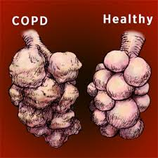
COPD – 3rd Leading Cause of Death in the US
Constant cough or “smoker’s cough”
Shortness of breath while doing activities that used to be easy
Excess sputum production
Feeling like you can’t take a deep breath
Wheezing
Most COPD patients were smokers at some point in their lives and the toxins from tobacco smoke directly resulted in the development of lung disease.
Other things that put you at risk include second-hand smoke, breathing in chemical fumes, dust or, air pollution over a long period of time.
Notes:
You may be more likely to get COPD if you had a lot of serious lung infections when you were a child. People who get emphysema in their 30s or 40s may have a disorder that runs in families, called alpha-1 antitrypsin deficiency. But this is rare.

Slide 21
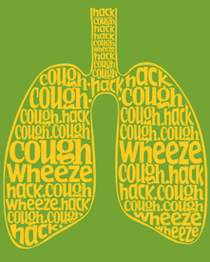
Are your lungs trying to tell you something?
Only a doctor can diagnose COPD
Report to your doctor
Ongoing cough
Shortness of breath
Fatigue
Wheezing
Notes:
To find out if you have COPD, a doctor will:
Do a physical exam and listen to your lungs.
Ask you questions about your past health and whether you smoke or have been exposed to other things that can irritate your lungs.
Have you do breathing tests, including spirometry, to find out how well your lungs work.
Do chest X-rays and other tests to help rule out other problems that could be causing your symptoms.
If there is a chance you could have COPD, it is very important to find out as soon as you can. This gives you time to take steps to slow the damage to your lungs.

Slide 22
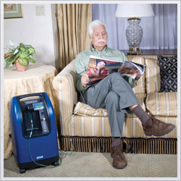
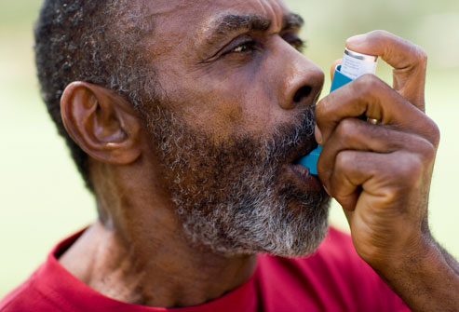
Treatment
O2 Therapy
Take your medicine as prescribed
Notes:
If you are a smoker, the single most effective treatment is quitting smoking.
•Take your medicine as prescribed by your doctor. These are usually inhalers that can open your airways and keep them from getting swollen. Some may be taken with a nebulizer, a machine that changes liquid medicine into a fine mist which makes it easier to inhale deep into the lungs.
•If your COPD is severe, oxygen therapy may be used to help with shortness of breath. This may be needed all day and all night or only part of the time. Be sure to understand how to safely use oxygen.
•Pulmonary Rehabilitation is a program that teaches you about COPD, how to exercise and how to manage your disease, and provides support and counseling. Most local hospitals/health systems have Pulm. Rehab programs.
•In some rare cases, surgery may be recommended for people with very severe COPD.

Slide 23
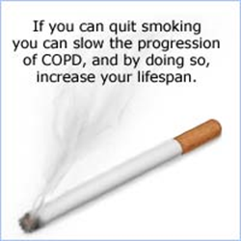
QUIT SMOKING
Notes:
If you smoke, you should make a plan to quit. If you live with someone who smokes, discuss ways to avoid or limit your exposure to tobacco smoke.
Contact: MAH (info on next slide), Kaiser (if applicable), your insurance company (customer service # usually on the card) or go to ACS , ALA or www.quitnet.com for more information. And many other web sites/apps – LiveStrong.com.

Slide 24
Notes:
For those with asthma or COPD who are on the state’s health insurance plan (COVACare and COVA HealthAware), did you know that you can choose to be part of an incentive program? Call ASAP to enroll – have to have 90 days compliance before Tier 1 and Tier 2 medication copays are waived!

Slide 25
Resources
American Academy of Allergy, Asthma and Immunology 1-800-822-2762 www.aaaai.org
American Lung Association 1-800-586-4872 www.lung.org
Asthma & Allergy Foundation of America 1-800-878-4403 www.aafa.org
National Asthma Education & Prevention Program 1-301-592-8573 www/nhlbi.nih.gov/about/naepp
COPD screening tool http://www.drive4copd.org/WhatisDRIVE4COPD.aspx
Virginia Asthma Coalition - http://www.virginiaasthmacoalition.org
Notes:
Many more resources available on our website and in the accompanying booklet.
ALA – toll free # is 800-LUNGUSA. Tons for information and services available to through ALA.

Slide 26
Questions?

Slide 27
Thank you!
Go to www.commonhealth.virginia.gov for more information.
Like us on facebook: www.facebook.com/commonhealthva
Visit DHRM’s website: www.dhrm.virginia.gov to become more familiar with health benefits.

