Slide 1
BABM
Helping the Commonwealth of Virginia’s workforce become the healthiest in the nation

Slide 2
You eat what you like…
and that’s okay!
Aim for
SMALL SHIFTS
Notes:
What your healthy meal plan looks like - Aim to make small changes to create an eating style that improves health now and in the future.

Slide 3
Start by adding VARIETY
VEGGIES
GRAINS
FRUITS
PROTEIN
DAIRY
Aim for all 5 food groups in a meal & 2-3 for a snack
Notes:
Variety
A healthy diet includes eating a variety of foods.
You will naturally consume the optimal nutrients from all food groups by including vegetables, fruits, lean protein, whole grains and dairy in your diet.
Plan ahead for meals to include most (if not all) food groups, and plan ahead for snacks to include at least two (preferably three) food groups.

Slide 4
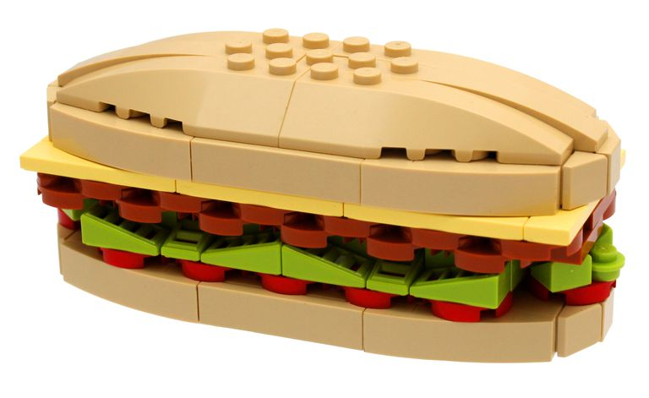
Moderate the AMOUNT
JUNIOR
JUMBO
LEGO CREDITS: PLYWORLD
Notes:
. Amount
The amount of food you eat is also an important part of building a healthy eating style. We have different calorie and nutrition needs based on our age, activity level and gender.
How much you eat and drink can affect your weight, and also your risk for heart disease, diabetes, and cancer.
Be aware of the amount of what you eat and drink during meals and snacks. You can cut down on calories by choosing smaller portions.
Food labels can help inform you about amount and calories of a serving size. Later in this program, we will look at some changes to the food label that should help them make more sense.

Slide 5
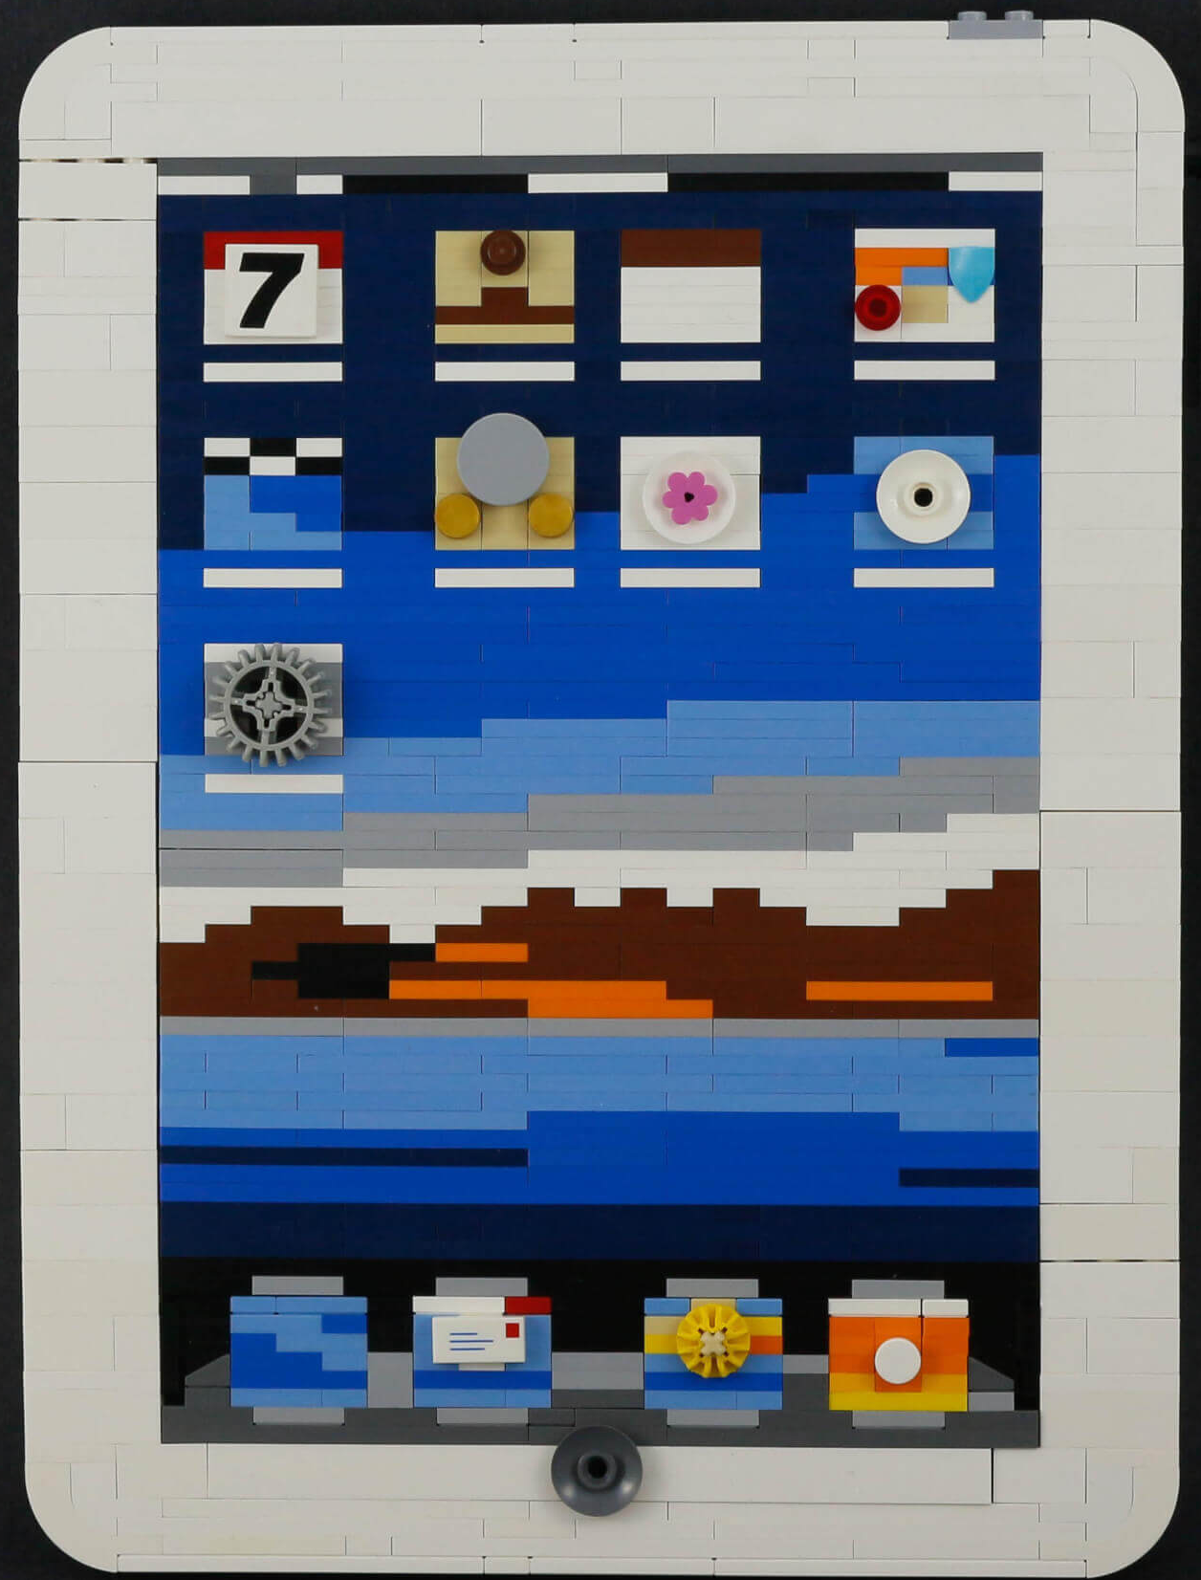
Use TOOLS to help maintain a healthy weight
Helpful apps & trackers
Take a photo
Journal or notebook
LEGO CREDITS: 123pricecheck
Notes:
*Add icons of useful apps to this slide once determined
Reaching and/or maintaining a healthy weight
As you age, manage your calories to stay at a healthy weight. This will prevent gradual weight gain over time.
Keep a food record or food diary can increase your awareness of calories consumed, amounts of food eaten, and serving sizes we have become accustomed to. This will help if we need to make changes to better align our eating habits with recommended dietary guidelines for good health.
There are online tools available on your phone, tablet or computer to help you periodically track what you eat and drink, and this can help you better understand your calorie intake and need overtime.

Slide 6
Get NUTRITION for your
LEGO CREDITS: Bric.com
Notes:
Eating healthy does not have to be expensive (but that is often an excuse used)
Plan your grocery list around your meals and snacks, and look for weekly specials.
Since half of your plate should be vegetables and fruits, aim to buy produce that is in season.
Check out your local farmer’s markets for the Virginia growing season—this can save money and taste delicious. (provide link or extra handout for Virginia Farmer’s Markets.)

Slide 7
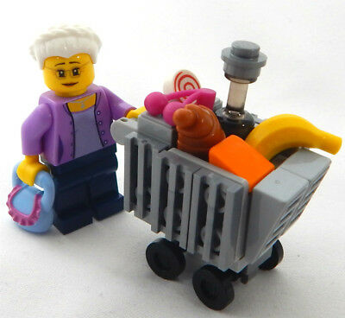
The grocery cart MIRRORS the plate
Aim to fill ½ of your cart with fruits and vegetables
LEGO CREDITS: mdmdjcmarket
Notes:
Our next section will go into more details to help you stay with your budget while still planning your healthy meals.
What your shopping cart looks like

Slide 8
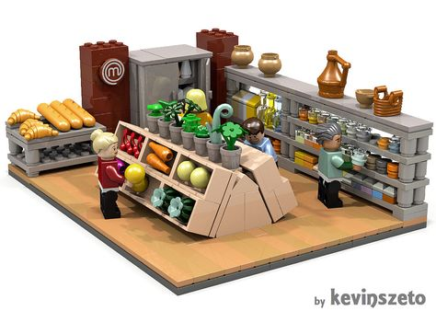
OUTSMART the store
Having a plan is important as many stores have over 40,000 items on the shelves. Ack!
Use a list grouped by item location to get in and out of the store quickly.
Use food labels to ensure you are spending your money on nutrition you need, not slick marketing.
Every aspect of the store has been heavily researched and designed to maximize profits.
Be aware of the effect of product placement and how that drives your decision making.
Notes:
How to outsmart the store
From the placement of products, display location even the lighting and music are heavily researched and planned by supermarkets and stores to make you purchase specific products (Moore and Yaroch 2016).
Grocery shopping sounds like a simple task and it can be, but with many stores carrying over 40,000 items on the shelves shopping can also be intimidating or at least distracting (Talukdar, D., & Lindsey, C. 2013).
Have you ever made a trip to the store and forgotten the main item you went in for but left with 2 bags of purchases you did not plan to buy? Were these items healthy choices or things that you normally eat? These tips will help you save time, money and keep you on tack on your next trip to the grocery store!
2. Avoid Impulse buys
Many store products are strategically placed for impulse buys. These items are often unhealthy (Moore & Yaroch 2016).
Where are these impulse buy areas? Near checkout counters
What type of items do you see in these impulse buy areas? Researchers found that many people have the underlying thoughts that “unhealthy food = tasty” and in contrast healthy food is bland. By placing “tasty” items in specific places shoppers are more likely to buy them (Talukdar, D., & Lindsey, C. 2013).
Are you familiar with product grouping, usually in a display of their own? Think chocolate near graham crackers and marshmallows

Slide 9
$$$ WASTERS
Buying produce without a plan
Buying in bulk without a plan
Buying produce out of season
Avoiding frozen foods
Avoiding canned foods
Getting snacks at the gas station
Notes:
Mistake No. 1: Buying Produce Without a Plan
Let’s be honest: Sometimes the pretty colors and unique shapes of produce lures you in. “Why yes, I do need this $3 dragon fruit for my fruit bowl.” No, you don’t—stick with more practical produce that you know you will eat. Or if you’re not sure what’s on your weekly menu, stick with heartier produce picks that won’t go bad quickly, like root veggies, hearty winter greens, squash, potatoes, apples, and citrus fruits.
Mistake No. 2: Frequenting Convenience Stores for Snacks
Do you buy a $2 mini bag of nuts at the convenience store for your afternoon snack? You might as well start lighting your money on fire right now. Just because convenience store snacks are small and, well, convenient, doesn’t always mean they’re cheap. Actually, they’re even more expensive when you opt for single-size portions.
Buy nuts and dried fruit from the bulk section at your local supermarket for a more economical option. If pretzels or chips are more your jam, purchase them online (Target, Walmart, and Jet.com have competitive prices and free shipping on larger orders) and pack your snacks to bring with you on the go.
Mistake No. 3: Buying Foods Out of Season
If you’re buying blueberries in the dead of winter, not only will they taste not great, they will also cost you an arm and a leg. To save money, try to have a basic understanding of which foods are harvested when. See harvest chart from USDA:
Mistake No. 4: Ignoring Frozen Foods
We’ve been told so many times to shop the perimeter of the supermarket, but it’s time to start ignoring that outdated recommendation. The frozen aisle actually offers a ton of healthy goodies, like frozen fruits and veggies. Not only are these items picked and immediately frozen to lock in nutrients, but they are usually much cheaper than fresh produce. And if you really can’t live without your blueberries in the winter, this is a good way to get them.
Mistake No. 5: Thinking Canned Foods Are Gross
Some foods just shouldn’t come in a can (we’re looking at you, sugary canned peaches), but other canned varieties are low-cost nutritious options. Canned beans and tomatoes are usually available in low- or no-salt varieties and come in BPA-free cans. For less than a few bucks, you can pick up some canned plant-based protein for taco night or canned tomatoes for Italian night. The best part is that these cans will stay good for months, so even if you end up going out for Taco Tuesday, your beans will be waiting the next time you want to cook at home.
Excerpted from: Greatist https://greatist.com/eat/money-saving-tips-for-food-shopping#6

Slide 10
Sensational SPRING Produce
Apples
Apricots
Asparagus
Avocados
Bananas
Broccoli
Cabbage
Carrots
Celery
Collard Greens
Garlic
Kale
Kiwifruit
Lemons
Lettuce
Limes
Mushrooms
Onions
Peas
Pineapples
Radishes
Rhubarb
Spinach
Strawberries
Swiss Chard
Turnips

Slide 11
Satisfying SUMMER Produce
Apples
Apricots
Avocados
Bananas
Beets
Bell Peppers
Blackberries
Blueberries
Cantaloupe
Carrots
Celery
Cherries
Corn
Cucumbers
Eggplant
Garlic
Green Beans
Honeydew Melon
Lemons
Lima Beans
Limes
Mangos
Okra
Peaches
Plums
Raspberries
Strawberries
Summer Squash
Tomatillos
Tomatoes
Watermelon
Zucchini

Slide 12
Awesome AUTUMN Produce
Apples
Bananas
Beets
Bell Peppers
Broccoli
Brussels Sprouts
Cabbage
Carrots
Cauliflower
Celery
Collard Greens
Cranberries
Garlic
Ginger
Grapes
Green Beans
Kale
Kiwifruit
Lemons
Lettuce
Limes
Mangos
Mushrooms
Onions
Parsnips
Pears
Peas
Pineapples
Potatoes
Pumpkin
Radishes
Raspberries
Rutabagas
Spinach
Sweet Potatoes & Yams
Swiss Chard
Turnips
Winter Squash

Slide 13
Worthwhile WINTER Produce
Apples
Avocados
Bananas
Beets
Brussels Sprouts
Cabbage
Carrots
Celery
Collard Greens
Grapefruit
Kale
Kiwifruit
Leeks
Lemons
Limes
Onions
Oranges
Parsnips
Pears
Pineapples
Potatoes
Pumpkin
Rutabagas
Sweet Potatoes Yams
Swiss Chard
Turnips
Winter Squash

Slide 14
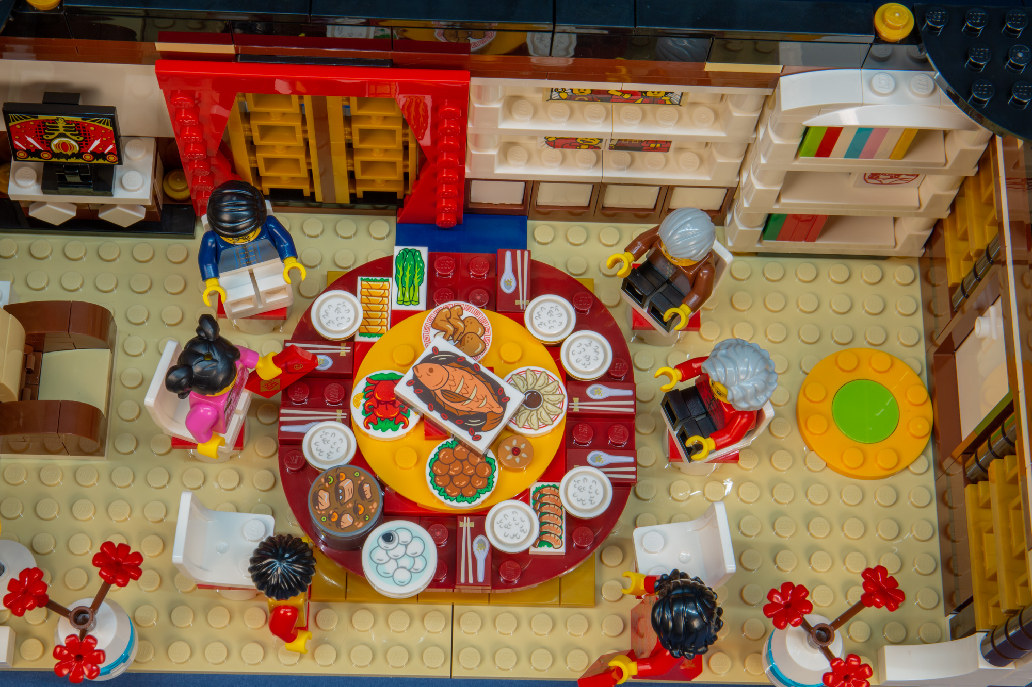
Make a plan that includes EVERYONE
Notes:
Let’s Plan – this is your key to staying on track and beating the stores marketing plan.
To start, sit down with the members of your household and write down everyone’s favorite meals. Look at the ingredients it takes to make these; are there healthier options for some ingredients (replace butter with olive oil, use red sauce in place of cream based sauce) (CDC.gov 2018). This will help you only purchase food that you need to make complete meals and reduces food waste along with cost.
Plan for where you will buy these items. Are their specialty items on the list that require a certain store? Planning where you buy can save not only money, but time as well if you have to make several stops visiting different stores. Also check for weekly specials, coupons or loyalty cards.
Stick to your list. If a food item is not on the list, don’t buy it. This will help prevent spending money on items that may be on sale but not in your normal diet.
Additional tools to help: Include apps
Big tip: Don’t shop hungry!!!!
Lego credits: Family Dinner set for Chinese New Year

Slide 15
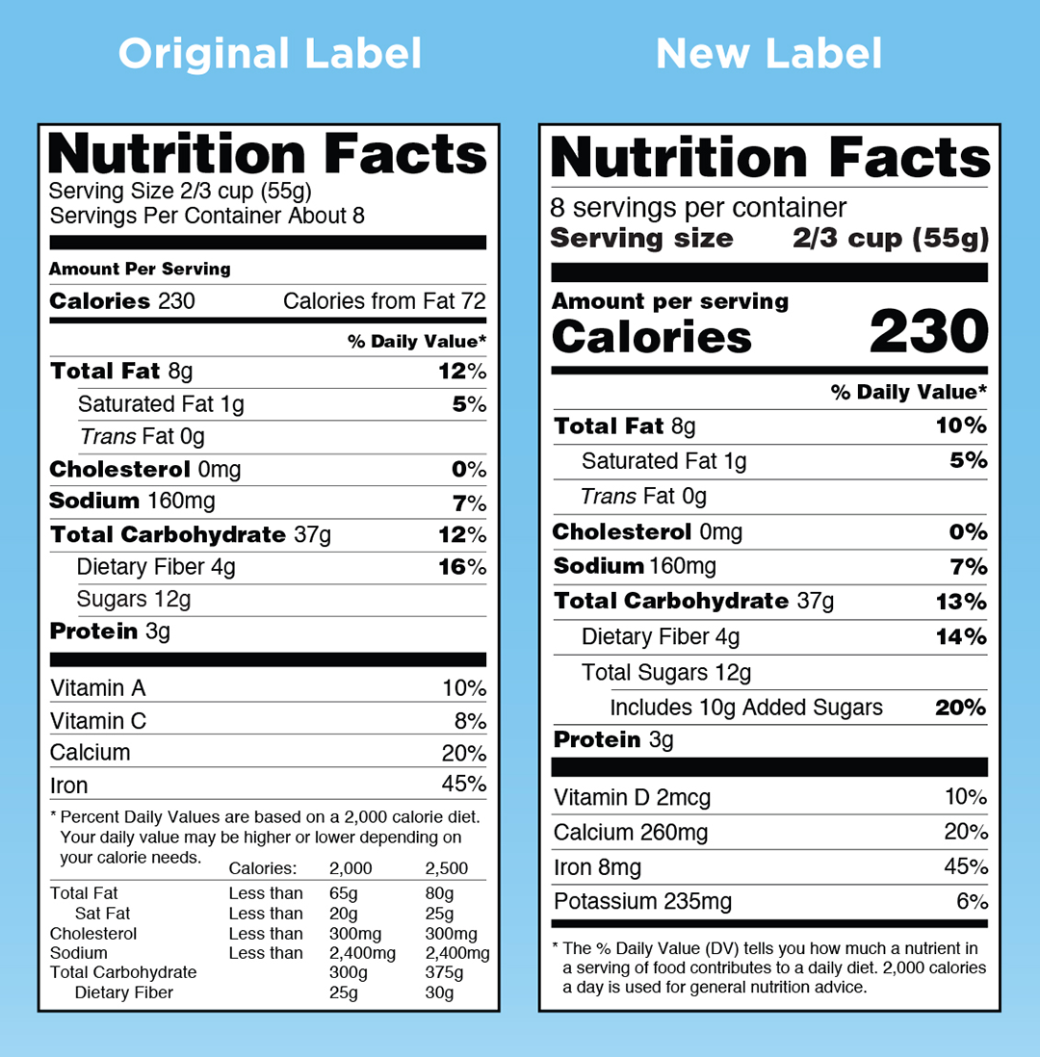
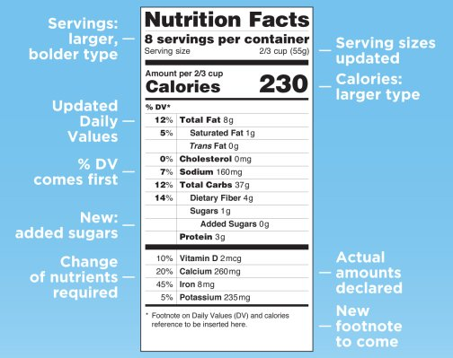
Use food LABELS
Notes:
When you are grocery shopping, it is a good time to read food labels. The new labels may make a bit more sense.
Here is a picture comparison of the old and new food labels, and listed below that are some updates that can help understand the food labels followed by a brief description of the changes.
“Added sugars,” in grams and as percent Daily Value, will be included on the label. Scientific data shows that it is difficult to meet nutrient needs while staying within calorie limits if you consume more than 10 percent of your total daily calories from added sugar, and this is consistent with the 2015-2020 Dietary Guidelines for Americans.
The list of nutrients that are required or permitted to be declared is being updated. Vitamin D and potassium will be required on the label. Calcium and iron will continue to be required. Vitamins A and C will no longer be required but can be included on a voluntary basis.
While continuing to require “Total Fat,” “Saturated Fat,” and “Trans Fat” on the label, “Calories from Fat” is being removed because research shows the type of fat is more important than the amount.
Daily values for nutrients like sodium, dietary fiber and vitamin D are being updated based on newer scientific evidence from the Institute of Medicine and other reports such as the 2015 Dietary Guidelines Advisory Committee Report, which was used in developing the 2015-2020 Dietary Guidelines for Americans. Daily values are reference amounts of nutrients to consume or not to exceed and are used to calculate the percent Daily Value (% DV) that manufacturers include on the label. The %DV helps consumers understand the nutrition information in the context of a total daily diet.

Slide 16
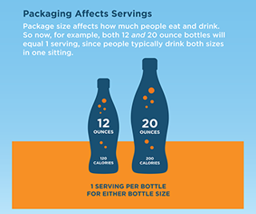
Serving size REFRESH
Notes:
By law, serving sizes must be based on amounts of foods and beverages that people are actually eating, not what they should be eating. How much people eat and drink has changed since the previous serving size requirements were published in 1993. For example, the reference amount used to set a serving of ice cream was previously 1/2 cup but is changing to 2/3 cup. The reference amount used to set a serving of soda is changing from 8 ounces to 12 ounces.
Package size affects what people eat. So for packages that are between one and two servings, such as a 20 ounce soda or a 15-ounce can of soup, the calories and other nutrients will be required to be labeled as one serving because people typically consume it in one sitting.
For certain products that are larger than a single serving but that could be consumed in one sitting or multiple sittings, manufacturers will have to provide “dual column” labels to indicate the amount of calories and nutrients on both a “per serving” and “per package”/“per unit” basis. Examples would be a 24-ounce bottle of soda or a pint of ice cream. With dual-column labels available, people will be able to easily understand how many calories and nutrients they are getting if they eat or drink the entire package/unit at one time.

Slide 17
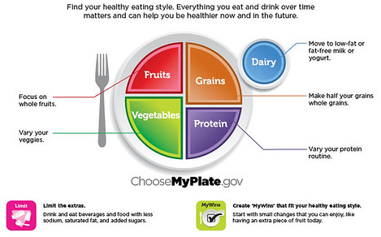
YOUR PLATE, YOUR WAY
Notes:
You successfully planned ahead, optimized your shopping cart, and you are ready to build your healthy meal! Here is a model to follow after based on the USDA ChooseMyPlate.gov. CommonHealth provided divided meal plates that include all the foods groups for optimal nutrition. If you plan your meal this way, you will be sure to get all necessary vitamins and minerals.
Healthy eating includes making vegetables, fruits, whole grains, lean proteins and low-fat/non-fat dairy. Be sure your food choices are low in saturated fats, sodium and added sugars. Let’s take a closer look at the benefits of each food group.

Slide 18
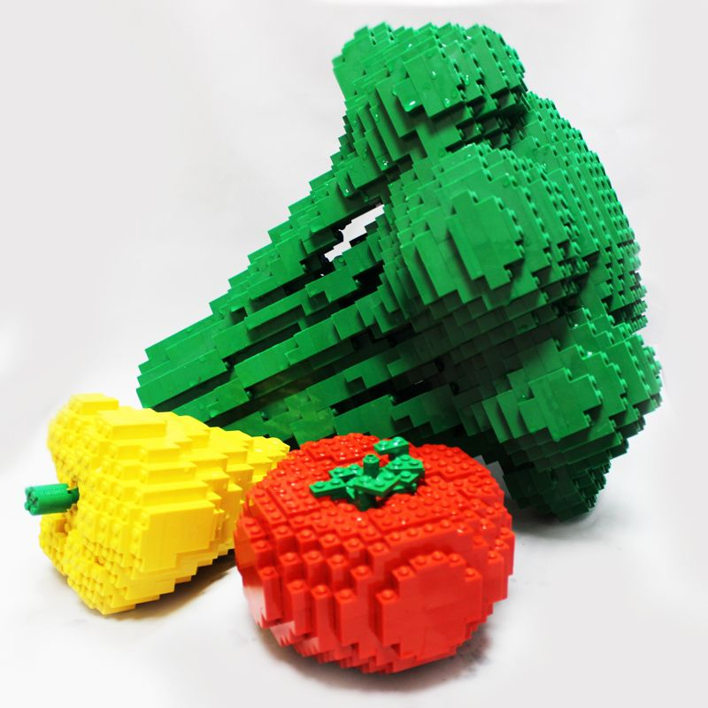
Half a plate of
VEGETABLES & FRUIT
Your palm is about 1 serving of cooked veggies and your fist is a serving of raw veggies
Your fist is about 1 serving of fruit
18
LEGO CREDITS: LEGOLAND
Notes:
Half of your plate should be vegetables and fruit. Why is that important?
People who eat more vegetables and fruits tend to have a reduced risk of some chronic diseases like heart disease, diabetes, and even certain types of cancers.
Consuming vegetables and fruits rich in potassium may lower blood pressure, and may also reduce the risk of developing kidney stones and help to decrease bone loss. Vegetable sources of potassium include sweet potatoes, white potatoes, white beans, tomato products (paste, sauce, and juice), beet greens, soybeans, lima beans, spinach, lentils, and kidney beans.
Most vegetables are naturally low in fat and calories. None have cholesterol. (Sauces or seasonings may add fat, calories, and/or cholesterol.)
Vegetables are important sources of many nutrients, including potassium, dietary fiber, folate (folic acid), vitamin A, and vitamin C.
Fiber-containing foods such as vegetables help provide a feeling of fullness with fewer calories Fiber is important for proper bowel function. It helps reduce constipation and diverticulosis.
Vitamin A keeps eyes and skin healthy and helps to protect against infections.
Vitamin C helps heal cuts and wounds and keeps teeth and gums healthy. Vitamin C aids in iron absorption.
RC Note – For longer programs, you may also want to discuss fruit and vegetable selection and how to wash fruits and veggies to prevent food borne illness - https://www.washingtonpost.com/news/voraciously/wp/2019/05/31/yes-you-need-to-wash-your-produce-heres-how/?utm_term=.cedd6787fe64
First, it’s best to wash produce right before you use it, because dampness encourages bacteria growth and therefore spoilage. The FDA recommends washing produce under cold running water — go ahead and wash your hands before and after you do the food, too. (If your bag of salad or other greens says it’s pre-washed, no further work is needed.) Scrub with a brush and/or gently rub the produce with your hands, depending on what you’re cleaning. Water is sufficient, so don’t use soap or bleach or even commercially made produce washes. Studies have found that distilled water was just as effective or more effective at removing microbes and pesticides (you can use clean cold tap water instead of distilled).

Slide 19
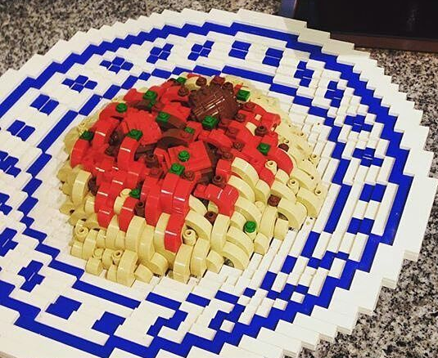
A quarter of a plate of
GRAINS (especially whole)
A handful is about a serving of crackers, pretzels, rice, or pasta
This meal sure could use a side salad
LEGO CREDITS: Elly Shuahili
Notes:
One quarter of your plate should be grains, especially whole grains. Why is that important?
Grains provide fiber, several B vitamins (thiamin, riboflavin, niacin, and folate), and minerals (iron, magnesium, and selenium).
Just like vegetables, fiber from whole grains helps reduce constipation and diverticulosis. Fiber-containing foods such as whole grains help provide a feeling of fullness with fewer calories.
The B vitamins thiamin, riboflavin, and niacin play a key role in metabolism – they help the body release energy from protein, fat, and carbohydrates. B vitamins are also essential for a healthy nervous system. Many refined grains are enriched with these B vitamins.
Folate (folic acid), another B vitamin, helps the body form red blood cells and is especially important for women of childbearing age.
The mineral magnesium helps in building bones and releasing energy from muscles, and selenium protects cells from oxidation. It is also important for a healthy immune system.

Slide 20
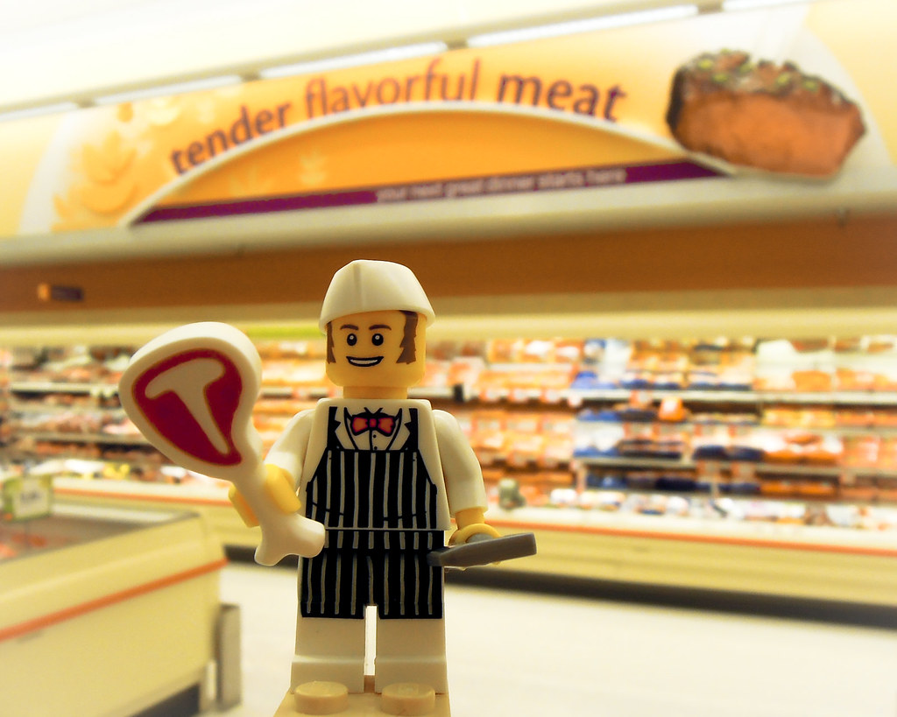
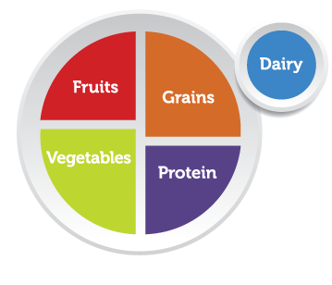
A quarter of a plate of
Lean PROTEIN
Your palm is about 1 serving of meat, fish, poultry, tofu, or beans
LEGO CREDITS: Elly Shuahili
Notes:
One quarter of your plate should be lean proteins. Why is that important?
Proteins include meat, poultry, fish, and eggs. Choose lean protein sources and limit processed meats.
Proteins also include vegetarian and vegan options like beans and peas, processed soy products, and nuts and seeds.
Proteins are vital for health and maintenance of your body; and work as building blocks for bones, muscles, cartilage, skin, and blood. They are also building blocks for enzymes, hormones, and vitamins.
Eat a variety of protein foods benefit from nutrients like B vitamins (niacin, thiamin, riboflavin, and B6), vitamin E, iron, zinc, and magnesium. B vitamins especially play a vital role in the function of the nervous system, aid in the formation of red blood cells, and help build tissues.
Iron is used to carry oxygen in the blood, and magnesium is used in building bones and in releasing energy from muscles.
Zinc is necessary for biochemical reactions and helps the immune system function properly.
EPA and DHA are omega-3 fatty acids found in varying amounts in seafood. Eating 8 ounces per week of seafood may help reduce the risk for heart disease.

Slide 21
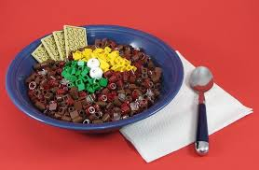
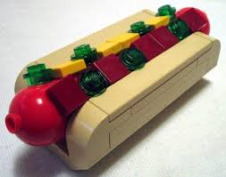
Swap out processed meats for BEANS or NUTS
LEGO CREDITS: LEGO Jack
Notes:
Eating peanuts and certain tree nuts (i.e., walnuts, almonds, and pistachios) may reduce the risk of heart disease when consumed as part of a diet that is nutritionally adequate and within calorie needs.
Because nuts and seeds are high in calories, eat them in small portions and use them to replace other protein foods, like some meat or poultry, rather than adding them to what you already eat. In addition, choose unsalted nuts and seeds to help reduce sodium intakes

Slide 22
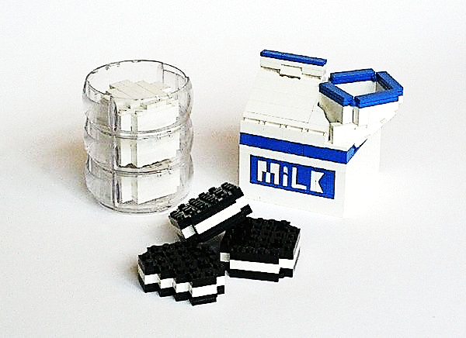
Don’t forget LOW FAT DAIRY
FRO-YO
Your thumb is about a serving of hard cheese, sour cream, or cream cheese
LEGO CREDITS: Moriorimi Chan
Notes:
Include low-fat dairy with your meal. Why is that important?
Calcium is used for building bones and teeth and in maintaining bone mass. Dairy products are the primary source of calcium in American diets. Diets that provide 3 cups or the equivalent of dairy products per day can improve bone mass.
Dairy products, especially yogurt, fluid milk, and soymilk (soy beverage), provide potassium and can help maintain healthy blood pressure.
Vitamin D functions in the body to maintain proper levels of calcium and phosphorous, thereby helping to build and maintain bones. Milk and soymilk (soy beverage) that are fortified with vitamin D are good sources of this nutrient
Milk products that are consumed in their low-fat or fat-free forms provide little or no solid fat.

Slide 23
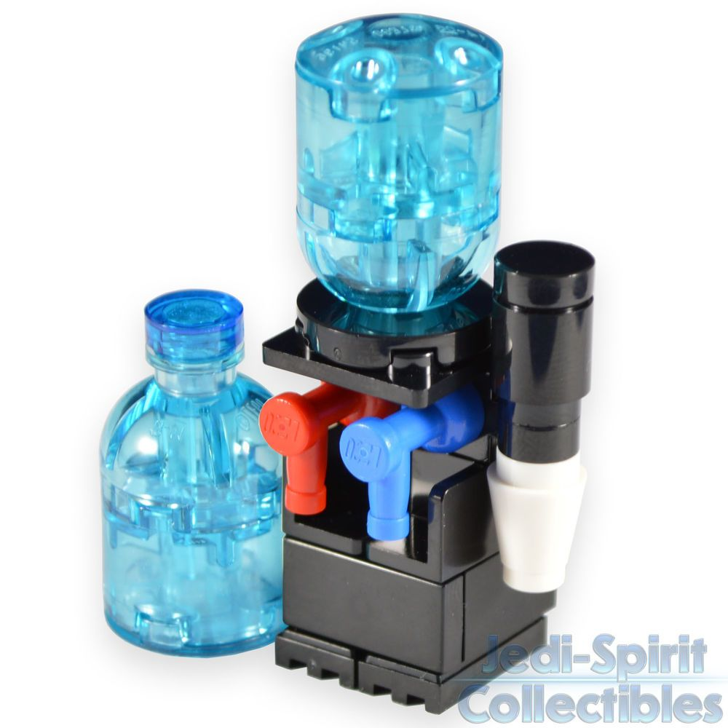
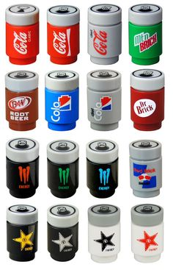
Rethink your DRINK
Why?
LEGO CREDITS: Legorific
Notes:
Take a closer look at your beverage!
An 8-ounce glass of orange juice in the morning, a couple of sodas throughout the day, a sports drink after working out, and maybe a beer or glass of wine in the evening – all of these add up. Many people don’t realize just how many calories they can add to a meal by including sweetened drinks. In fact, beverages are responsible for almost half of all the added sugars in the American diet.
According to research published in the International Journal of Obesity, calories from liquids, such as soft drinks, sports beverages or sweetened tea, don’t seem to register as food. Thus, consuming these with your meal, instead of water or another calorie free beverage, will impact your health and weight over time.
Participants in a study at Purdue University were asked to consume 450 calories worth of jelly beans every day for four weeks and 450 calories worth of soda every day for another four weeks. On days they ate the jelly beans, the participants compensated by eating roughly 450 fewer calories from other foods. Therefore, they ingested no more calories than usual. But on days they drank the soda, the participants didn’t compensate. They ended up eating roughly 450 more calories than usual. Results like this let us know that beverages are a significant contributor to weight gain and associated healthy problems and they are often overlooked. Liquid calories don’t trip our satiety mechanisms; they just don’t register like solid foods.
Be aware of how many sweetened drinks you are consuming and try to make adjustments to consume more beverages without calories. Here is how easily sweetened daily beverage calories can add up and suggested modifications.
8oz. of juice with breakfast - 110 calories (instead include a serving of whole fruit with breakfast such as ½ banana, cup of berries 50 cal.)
Coffee with cream and sugar - 90 calories ( drink coffee or tea black or use no calorie sweeteners like stevia and low fat /skim milk or fat free half & half – a 0 -45 calories)
24 oz. of soda with lunch – 280 calories (enjoy plain, sparkling or flavored water – 0 calories)
12 oz. beer or 5 oz. glass of wine in the evening - 125-150 calories -try light beer (100 calories) or a wine spritzer (75 calories) or even better, a flavored sparkling water (0 cal.)
Total: 605-630 calories in a day (95- 195 calories in a day)
Also be aware of portion sizes, supersized sodas contain a quart or more – that’s huge! And don’t forget to count those free refills when eating out!
Water gets boring, we get it. Change things up a bit and add flavor to your water with interesting recipes to Rev Your Bev from our friends at Virginia Foundation for Healthy Youth and be sure to check out their Flavor Finder to find your perfect blend!

Slide 24
Eat well MOST of the time
Notes:
Eating well most of the time
By following these build a better meal guidelines, we should be able to fuel our bodies with necessary nutrients. Including physical activity and moving more in our daily lives is also a recommendation. If these conditions are met, is it possible to enjoy a scoop of ice cream or a slice of birthday cake? Although the balance may be different for everyone, we all have room for moderation.
Moderation is not a popular concept. While eating in moderation is becoming an emerging trend, we Americans generally tend to eat whatever and whenever we want. We alternate between either binging on sweets and fatty foods, or cleanses and deprivation diets. But eating sensibly while occasionally enjoying a decadent treat? It just makes too much sense. So here are some top tips for eating in moderation:

Slide 25
Establish your GUIDING PRINCIPLES
Half of my plate will be vegetables at most meals
Half of my grains will be whole grains
I will focus on whole fruit and enjoy its natural sweetness
I will eat beans as a protein source once a week
I will have milk or plain yogurt more often
Notes:
Develop a guiding principle. Decide what moderation looks like to you. To some, it’s eating meat, sweets, and processed foods occasionally. In practice, this means you generally eat vegetables at home, but when going out to eat or being a guest in someone’s home, all bets are off. You have no quotas or rules, which makes it sustainable. This is what we’ve found works best for most people. Before you start pursuing moderation, decide what works best for you and your lifestyle!
Enjoy what’s meant to be enjoyed. Treats are just that: treats! And treats are meant to be enjoyed. While you savor your break from eating in moderation, try to avoid the typical guilty talk (“I know I shouldn’t be eating this”) and instead focus on the pleasure of the experience.
Out of sight out of mind. Buying less of the food you’re trying to limit is key to a moderate approach. Try to limit your purchase of processed and sweet-filled foods since if you can see it in the kitchen, it’s difficult to avoid. Instead, stock up on healthy snack foods and desserts like nuts, veggies and hummus, berries and yogurt, small pieces of dark chocolate, etc.

Slide 26
Engage your MIND
Notes:
Allow time for your taste buds to change. It may take a few months, but once you we switch your diet to whole foods, the less you crave sugary and processed foods. If you’re working on this, don’t give up! It takes time for your tastes to change. It’s definitely a challenge to not give in to sugar cravings once in a while, but your urges for sugar should decline quite a bit.
Engage in mindfulness. Eating mindfully is being fully aware of the food you are eating — including avoiding hand-to-mouth snacking or multitasking. This goes hand in hand with enjoying your indulgences with a present mind. Practice that mental presence for everyday eating too; you may find it’s more enjoyable in the long run.
Don’t beat yourself up. Oh well, so you messed up and overdid it? It’s okay. We all do it and instead of being guilty, give yourself the grace to try again tomorrow. You’ll find that over time it’s more sustainable to try with a positive outlook than to beat yourself up with guilt complexes.

Slide 27
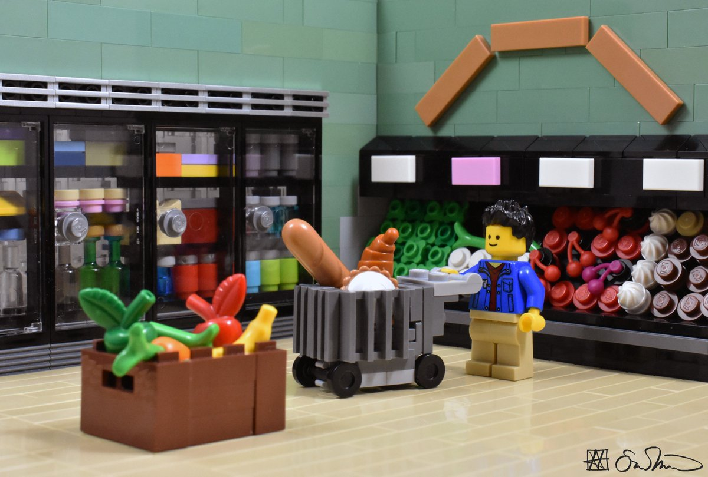
Be ready with your PLAN
Notes:
Use portion size to your advantage. Try smaller portions of desserts or treat foods. You can make small desserts in your house so that you can end on a sweet treat instead of a sick stomach. Even just a few bites can fulfill a sugar urge.
Strive for variety and balance. When your dinner is full of interesting flavors and textures with lots of variety in food groups, you don’t tend to crave after dinner snacks or treat foods to make up for a lousy dinner.
Plan ahead. Like anything, eating in moderation involves planning ahead to make sure healthy foods are readily available and other foods are less so. Take a few moments to be intentional in your food planning and lifestyle patterns to support your guiding principle of moderation.

Slide 28
Creative MEAL IDEAS
https://www.youtube.com/watch?v=XPubP0Kz9OY
Notes:
Mason Jar Meals - https://www.youtube.com/watch?v=XPubP0Kz9OY
Make Ahead Meals - https://www.youtube.com/watch?v=laAj2s7BUwo
5 Easy Weeknight Dinner ideas - https://www.youtube.com/watch?v=7_9bjux2FEg

Slide 29
You are the architect of your life
Your choices today build the foundation for your future self
BUILD A MASTERPIECE
Notes:
What do you want to be made of?
Be a master builder!

Slide 30
QUESTIONS?
Contact us at CommonHealth.Virginia.gov or at DHRM’s Office of Employee Programs
Notes:
Sources:
Choosemyplate.gov
Food and Health Communications / foodandhealth.com
Moore, L. lvmoore@cdc. go., Pinard, C., & Yaroch, A. (2016). Features in Grocery Stores that Motivate Shoppers to Buy Healthier Foods, ConsumerStyles 2014. Journal of Community Health, 41(4), 812–817. https://doi-org.proxy195.nclive.org/10.1007/s10900-016-0158-x
Healthy Weight. (2018, September 18). Retrieved from https://www.cdc.gov/healthyweight/healthy_eating/meals.html
Talukdar, D., & Lindsey, C. (2013). To Buy or Not to Buy: Consumers’ Demand Response Patterns for Healthy Versus Unhealthy Food. Journal of Marketing, 77(2), 124–138. https://doi-org.proxy195.nclive.org/10.1509/jm.11.0222
University of Illinois Extension, https://web.extension.illinois.edu

