Slide 1
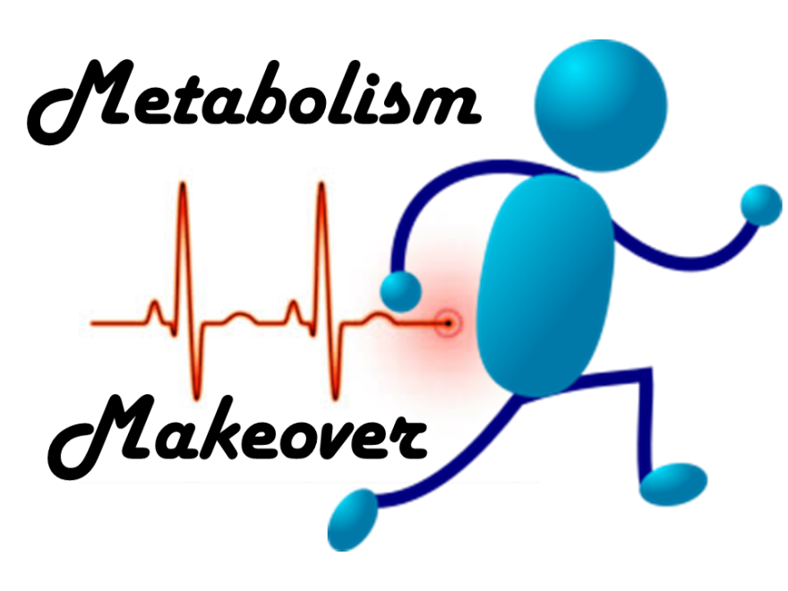
CommonHealth.Virginia.Gov
Notes:
Why can one person eat like a growing teenager and not gain a pound, while another person's every indulgence shows up on the scale?
Chalk it up to individual differences in metabolism, muscle mass and physical activity. Metabolism is the process by which our bodies convert what we eat into the energy we need to survive and function. It powers everything from breathing to blinking. A fast metabolism is like a hot furnace that burns through fuel (calories) quickly. A slow metabolism needs less fuel to keep a body running.
It's tempting to throw up our hands and blame weight issues on a slow metabolism. But don’t throw in the towel just yet! Today, CommonHealth is going to show that there are ways to support metabolism and maintain a healthy weight.

Slide 2
METABOLISM – The body’s process of using food for energy
Notes:
So, what is metabolism again? Metabolism is the body’s process of converting food into energy that we need to survive and function on a day to day basis. This energy is used to stay warm, move around and keep vital organs functioning.
For people who are trying to lose weight, increasing your metabolic rate leads you to losing more weight without cutting more calories out of your diet. CommonHealth will provide you with some tips that you can follow to help with boosting your metabolic rate, but first let’s look at what factors influence the process.

Slide 3
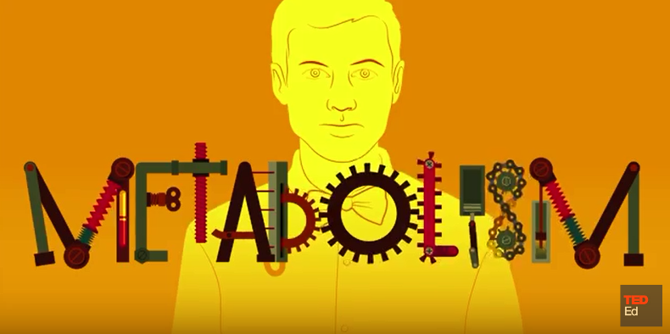
TED Ed – How does the thyroid manage your metabolism?
Notes:
https://www.youtube.com/watch?v=iNrUpBwU3q0
Deep in the tissues of your neck is a small, unassuming organ that wields enormous power over your body: the thyroid. Emma Bryce explains how the thyroid, like the operations manager in a company, is tasked with making sure that all the cells in your body are working properly. Also addresses hyper and hypo-thyroid conditions.
Lesson by Emma Bryce, animation by Tremendousness.

Slide 4
What affects metabolism?
Body size and composition
Sex
Age
Nutrition
Physical Activity
Notes:
Even when you're at rest, your body needs energy for all its "hidden" functions, such as breathing, circulating blood, adjusting hormone levels, and cell development and repairing cells. The number of calories your body uses to carry out these basic functions is known as your basal metabolic rate — what you might call metabolism. Energy needs for your body's basic functions stay fairly consistent and aren't easily changed.
Several factors determine your individual basal metabolism, including:
Your body size and composition. People who are larger or have more muscle burn more calories, even at rest.
Your sex. Men usually have less body fat and more muscle than do women of the same age and weight, which means men burn more calories.
Your age. As you get older, the amount of muscle tends to decrease and fat accounts for more of your weight, slowing down calorie burning.
In addition to your basal metabolic rate, two other factors determine how many calories your body burns each day:
Nutrition and how your body processes food(thermogenesis). Digesting, absorbing, transporting and storing the food you consume also takes calories. About 10 percent of the calories from the carbohydrates and protein you eat are used during the digestion and absorption of the food and nutrients.
Physical activity. Physical activity and exercise — such as playing tennis, walking to the store, chasing after the dog and any other movement — account for the rest of the calories your body burns up each day. Physical activity is by far the most variable of the factors that determine how many calories you burn each day.

Slide 5
what can you control?
YOUR ENGINE
YOUR FUEL CONSUMPTION
YOUR MAINTENANCE
MOVE MORE
EAT WELL
SLEEP BETTER
Notes:
When it comes to metabolism, there are a few things you can control!
Your body (engine) – move it more and plan physical activity in your day. Aim for a little everyday!
What you eat, your calories consumed (fuel consumption) – look at food labels and ingredient lists. Aim for more whole foods you make at home, and less pre-packed, store bought convenience foods. These tend to be high in calories and low in nutrition.
Your body maintenance and how you take care of your body (getting enough rest and sleep) – our body’s run differently when we are sleep deprived.

Slide 6
MOVE MORE
REV YOUR ENGINE WITH STRENGTH TRAINING
Notes:
Adding strength training to build lean muscle boosts your metabolic rate. The benefits of weight training as it increases muscle mass make the most difference for our metabolism. Aerobic exercise like walking–isn’t as good at maintaining muscle mass, especially as we age (you lose a little and gain a little with a walking program). Make sure that you are doing some sort of strength training/resistance training as it results in increasing muscle mass much more efficiently.
Muscle burns more calories than fat so the more muscle you have, the higher your metabolic rate. The best part about weight training is that every ounce of muscle you gain burns more calories even when you are sleeping or at rest.
If lifting weights or using machines at the gym isn’t your style, try using your body weight as resistance. Exercises like chair squats and wall push ups build muscles, too! (During a long program, you can ask participants to try a few. Get them up from sitting the whole time.)

Slide 7
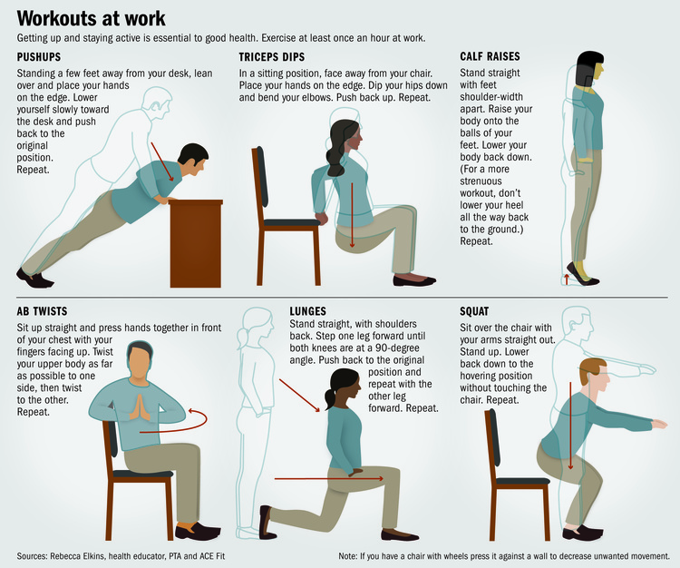
Try it out
Notes:
If a long program allows time, plan to have the participants try a few.

Slide 8
Try it out II
Notes:
Squats should be performed with knees behind toes.

Slide 9
A need for Speed
Make the most of your walks
Try intervals to up the intensity
Walk for 5 minutes then speed walk or jog for 1 minute
Repeat
Notes:
Aim to move more everyday! Set your goal to reach at least 30 minutes, even if you start at 10-15 minutes a day.
Research is ongoing, but many experts agree that metabolism increases during a workout and remains slightly elevated for a short time after exercise. It is important to get that in almost everyday, so exercising in the morning may help you to stay on track.
Intensity does matter when exercising. It should not hurt (the old no pain no gain philosophy is not what we are suggesting); however, you should get a little uncomfortable and actually feel your heartrate increase. Working at a good intensity level would be reaching a point of being slightly out of breath.
Try intervals when you walk 5 minutes, then power walk or jog if you can for 1 minute. Recover for 5 minutes of walking and try the interval again.
Work up to it – every step is a step in the right direction.

Slide 10
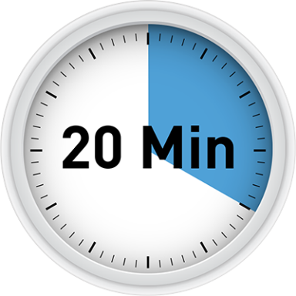
At the very least… Sit less and stand more
Max time
on your
backside!
Notes:
Try to get up and stretch, get copies from the copy room, walk to a co-worker instead of calling with a question…think of ideas to get up from your chair at least once an hour.

Slide 11
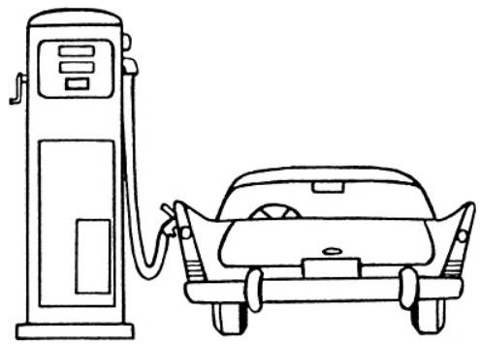
EAT WELL
HIGH TEST
FUEL
FOR
HIGH TEST PERFORMANCE
Notes:
You know the basics – you are what you eat!
Many of us are seeking a way to see big results quickly though…and marketers know this. Being aware of what sounds too good to be true can save you time, money, and trouble however. With all the focus on weight in our society, it isn't surprising that millions of people fall prey to fad diets and bogus weight-loss products. Conflicting claims, testimonials and hype by so-called "experts" can confuse even the most informed consumers.

Slide 12
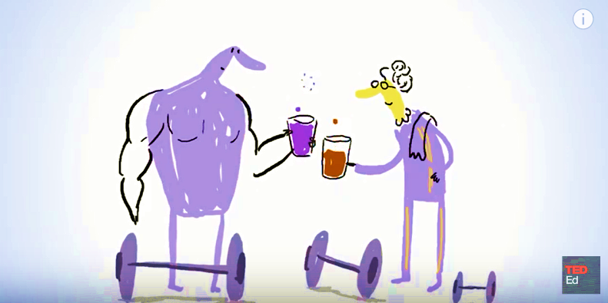
DO FAD DIETS ACTUALLY WORK?
TED Ed – How to spot a fad diet?
Notes:
https://www.youtube.com/watch?v=8V15Z-yyiVg
It depends on what you mean by “work.” There are no foods or pills that magically burn fat. No super foods will alter your genetic code. No products will miraculously melt fat while you watch TV or sleep. Some ingredients in supplements and herbal products can be dangerous and even deadly for some people.
Many fad diets dramatically restrict your calories (<1,200 calories per day), which has a negative effect on your metabolism. The body conserves energy by slowing down metabolism so that it can do the bare minimum to take care of vital organ function. The most damaging part of these diets is that the initial weight loss will slow your metabolism (because you lose muscle), leading to later weight gain. Much of the weight lost is also water weight.
Additionally, because of restrictions they place on types of foods (carbs, fat, etc.), unbalanced diets may lead to nutritional deficiencies.
Instead, focus on making a healthy lifestyle change. Try going meatless once a week. Or skip the fat-filled sauces and dressings whenever you can. Little changes like that can make a huge difference. No cheese = 100 saved calories.
Example diets – loss of muscle mass

Slide 13
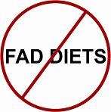
Rapid weight loss
Unlimited quantities or food group limitations
Specific food combinations
Rigid menus
No need to exercise
Notes:
Steer clear of any diet plans, pills and products that make the following claims:
Rapid Weight Loss
Slow, steady weight loss is more likely to last than dramatic weight changes. Healthy plans aim for a loss of no more than 1 to 2 pounds per week. If you lose weight quickly, you'll lose muscle, bone and water. You also will be more likely to regain the pounds quickly.
Quantities and Limitations
Ditch diets that allow unlimited quantities of any food, such as grapefruit and cabbage soup. It's boring to eat the same thing over and over and hard to stick with monotonous plans. Avoid any diet that eliminates or severely restricts entire food groups, such as carbohydrates. Even if you take a multivitamin, you'll still miss some critical nutrients.
Specific Food Combinations
There is no evidence that combining certain foods or eating foods at specific times of day will help with weight loss. Eating the "wrong" combinations of food doesn't cause them to turn to fat immediately or to produce toxins in your intestines, as some plans claim.
Rigid Menus
Life is already complicated enough. Limiting food choices or following rigid meal plans can be an overwhelming, distasteful task. With any new diet, always ask yourself: "Can I eat this way for the rest of my life?" If the answer is no, the plan is not for you.
No Need to Exercise
Regular physical activity is essential for good health and healthy weight management. The key to success is to find physical activities that you enjoy and then aim for 30 to 60 minutes of activity on most days of the week.
If you want to maintain a healthy weight, build muscle and lose fat, the best path is a lifelong combination of eating smarter and moving more.

Slide 14
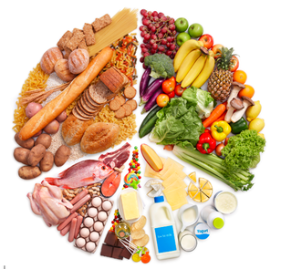
FUEL UP
IN BALANCE
Notes:
Get the balance right to fuel up effectively.
Choose variety: The best meals have a balance of items from different food groups.
Half of your plate should be vegetables and fruits.
About one-quarter of your plate should be grains and one-quarter protein.
Drink fat-free or low-fat (1%) milk and water instead of soda, sports drinks, and other sugary drinks.
Avoid oversized portions.
Eating protein and some healthy fats (monounsaturated or polyunsaturated) combined with fruit, vegetable or carbs at every meal or snack slows down absorption into the bloodstream. This helps you feel full longer prolonging satiety and protein and fat take longer to metabolize.
Balance your meals by trying to include fruits, vegetables, low fat dairy and whole grains with every meal.

Slide 15
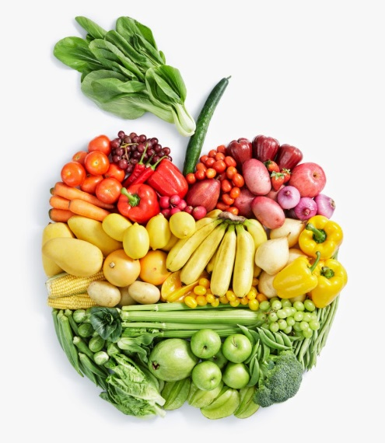
Eat Smaller, more Frequent Meals
Eating gives a small boost in metabolism
Less likely to overeat or binge
Prevent shift into starvation mode
Notes:
The human body needs food as a source of energy for survival. Eating actually increases metabolism due to the energy required for digestion and absorption of food. Those who eat more often prevent a shift into starvation mode, as well as a decrease in their metabolism — a natural reaction and internal process that protects energy and prevents starvation.
In addition, people eating several smaller meals are less likely to overeat or binge at a later meal in the day like nighttime.
Eating more often can help you boost your metabolism and lose weight. When you eat large meals with many hours in between, your metabolism slows down between the meals. Having a small meal or healthy snack every 3-4 hours keeps your metabolism humming so you burn more calories throughout the day.

Slide 16
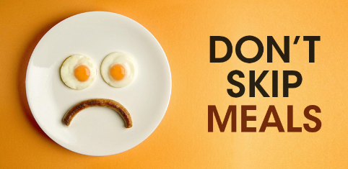
PLAN AHEAD INSTEAD
Notes:
Eating increases metabolism due to the energy required for digestion and absorption of food.
Skipping a meal causes a decrease in metabolism until you eat something.
Skipping breakfast and/or lunch means you miss two chances to boost metabolism and burn those calories.
Skipping also can lead to eating bigger meal at dinner and snacking all night-with a sluggish metabolism.
You must plan ahead for snacks at work and meals – take a few minutes each week to plan ahead.
For inspiration, try… (meal planning websites or myplate suggestions here)

Slide 17
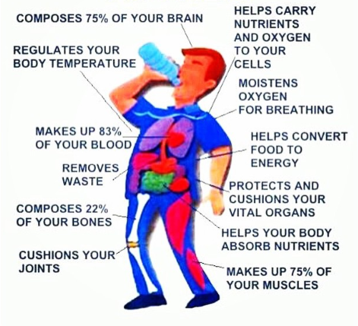
WATER IS BEST FOR YOUR BODY
Notes:
Our bodies need water to remove impurities, stay hydrated and assist organ functions.
If we allow ourselves to become dehydrated, we may be more likely to reach for a snack thinking it’s hunger.
Some studies, including one done by The Journal of Clinical Endocrinology & Metabolism , have shown that increasing your water intake leads to a slight boost in metabolism. Your body may burn a few calories heating the cold water to your core temperature. Though the extra calories you burn drinking a single glass doesn't amount to much, making it a habit can add up to pounds lost with essentially zero additional effort.
So skip the sugary, carbonated beverages to avoid empty calories.

Slide 18
BREAKFAST
IN YOUR TANK
Fuel up and energize
Burn calories more efficiently
Curb hunger
Stabilize blood sugar levels
Help you think more clearly
Notes:
Research has shown that the benefits of eating breakfast each day can help you:
Fuel up for the day and have the energy to get going
Burn calories more efficiently (as there is a slight increase in metabolism) instead of storing them as fat
Curbs hunger so you won’t binge at lunch or snack time
Stabilizes blood sugar levels and prevent the lows
Helps with thinking clearly since the brain needs glucose to function.

Slide 19
UP FOR A Challenge? Breakfast IS SERVED!
A month of starting your day feeling charged and ready to go!
Eat a healthy breakfast
as often you can
Aim for:
300-400 calories
at least 3-4 grams of fiber
at least 6 grams of protein
Notes:
Refer participants to challenge – provide handout if needed.

Slide 20
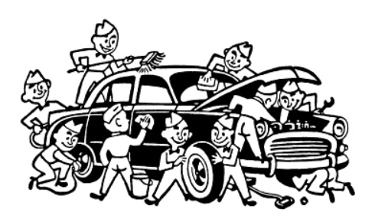
Proper maintenance extends Life
SLEEP
BETTER
Notes:
Studies have shown that when people don't get enough sleep they:
• Have increased levels of a hunger hormone called ghrelin and decreased levels of the satiety/fullness hormone called leptin, which could lead to overeating and weight gain.
• Consume about 300 calories a day more than when they are well-rested. Overall, most of the extra calories came from high-fat foods.
• Snack more and do less physical activity.
• Eat more than what is needed to cover the energy cost of staying awake longer, especially at night, which can lead to significant weight gain.
https://www.usatoday.com/story/news/nation/2014/07/20/sleep-loss-weight-gain/7507503/

Slide 21
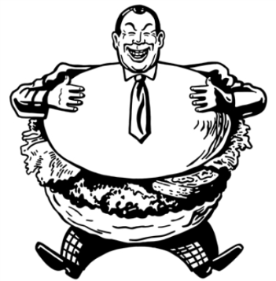
OVEREATING
Is a poor night’s sleep to blame?
Sleep helps maintain a healthy balance of the hormones that make you feel
hungry (ghrelin) or full (leptin).
Sleep
Hunger
Fullness
Notes:
There is growing interest and evidence that sleep loss and sleep disorders have a significant impact on metabolism. Laboratory studies have clearly shown that sleep deprivation can alter the glucose metabolism and hormones involved in regulating metabolism, that is, decreased leptin levels and increased ghrelin levels.
https://www.ncbi.nlm.nih.gov/pmc/articles/PMC2929498/
Also discusses diabetes connection

Slide 22
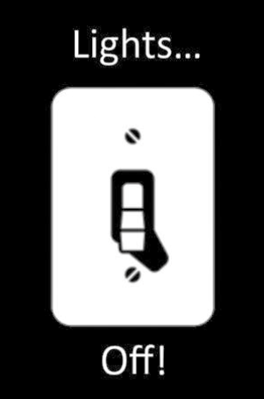
COLD
DARK
QUIET
Notes:
Set yourself up for the best night sleep!
Block out noise
Use darkening shades or curtains
Keep the temperature slightly cooler in the bedroom
Wear comfortable sleeping clothes

Slide 23
Notes:
Don’t let lack of good sleep interrupt your attempts at a healthy lifestyle and efficient metabolism. Make plans to follow up with your doctor.
If you think you may have a sleep disorder like sleep apnea, there are steps you can take to improve a restful night sleep. You can start with your own home evaluation and then follow up in a sleep lab if necessary. It could be covered under your health insurance plan. Contact the Office of Health Benefits at ohb@dhrm.virginia.gov or (804) 225-3642 in Richmond or 1-888-OHB-4414 (888-642-4414).

Slide 24
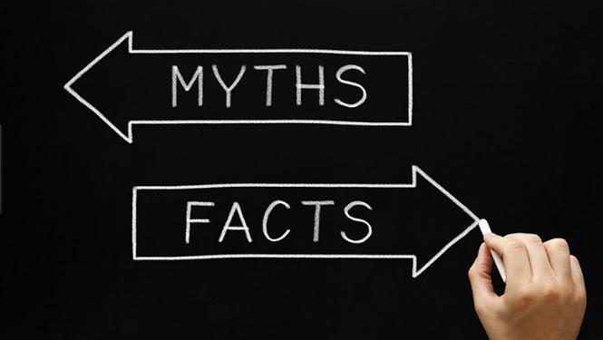
Green tea
Spicy foods
Aging
Notes:
While there’s no magic food that will speed up metabolism, some studies have shown that green tea and hot chilies temporarily boost metabolic rates. It’s important to note that the small increase isn't enough to offset eating too many calories.
When combined with a healthy diet and regular exercise, green tea may boost your metabolism slightly. Green tea leaves contain a plant compound called ECGC (spell out acronym here) that promotes fat metabolism. Drinking green tea is not a significant way to lose weight or boost metabolism. In addition, hot chilies or spicy food may cause us to eat less because they are hot. Also not significant enough to boost metabolism causing weight loss. If you enjoy them, include them; however, there’s no real evidence to consuming them to increase metabolism.
Aging doesn’t have to mean a decrease in metabolism. Maintaining and building lean muscle mass through resistance training and strength provides benefits of an efficient metabolism.

Slide 25
GET IN THE DRIVER’S SEAT
MOVE MORE
Include strength training
EAT WELL
Small, frequent meals with plenty of water
SLEEP BETTER
Make it a priority
Notes:
Let’s review quickly what we covered so you can use these useful tools and get started!
Metabolism is the body’s process of converting food into energy that we need to survive and function on a day to day basis. We can get the most out of our metabolism by:
Getting regular physical activity
Including strength training a couple times a week to build lean muscle tissue
Following a healthy eating plan – not skipping meals and eating smaller, frequent meals
Eating Breakfast Staying hydrated with water
Sleeping better by practicing sleep hygiene

Slide 26
Questions?
Visit the CommonHealth website at
www.commonhealth.virginia.gov
for more great resources
Notes:
Thanks for participating!!!
Sources (not all inclusive, just a few here):
https://www.ncbi.nlm.nih.gov/pmc/articles/PMC425077/
https://academic.oup.com/jcem/article/88/12/6015/2661518/Water-Induced-Thermogenesis
http://www.eatright.org/resource/health/weight-loss/tips-for-weight-loss/metabolism-myths-and-facts
http://www.eatright.org/resource/health/weight-loss/fad-diets/staying-away-from-fad-diets
https://www.mayoclinic.org/healthy-lifestyle/weight-loss/in-depth/metabolism/art-20046508

