Slide 1
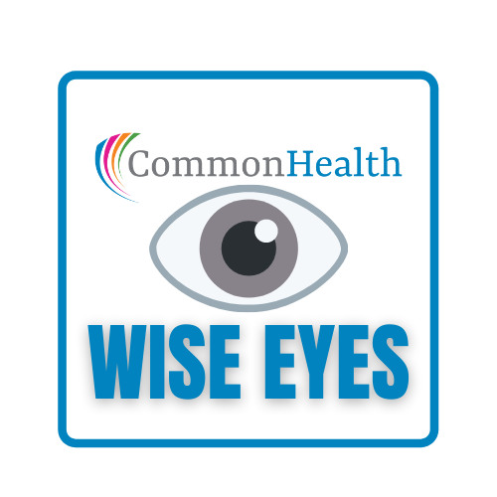
A GUIDE TO HEALTHY VISION
Notes:
CommonHealth has been serving state employees with wellness education for over 35 years! (WCs - Feel free to share more information or events going on in your territories.)
Today were taking a closer look at healthy vision……
INTRO-
Vision is often underappreciated and taken for granted all too easily. However, as it changes or is lost to differing degrees, it greatly affects one’s life. There are so many things we can do to keep our eyes healthy and strong as well as strategies we can use to help with changes and minimize the impacts of chronic diseases on vision.
When it comes to having good vision for a lifetime, it’s ultimately important to be in good overall health. Protecting your eyes from the sun and from trauma is important, but eating right, exercise, and regular checkups can go a long way to prevent other sorts of ocular health problems later in life.
You also have a Wise Eyes booklet that will provide helpful information as we go along. We can do this together and learn how to play it safe with your sight to preserve and protect it for a lifetime.

Slide 2
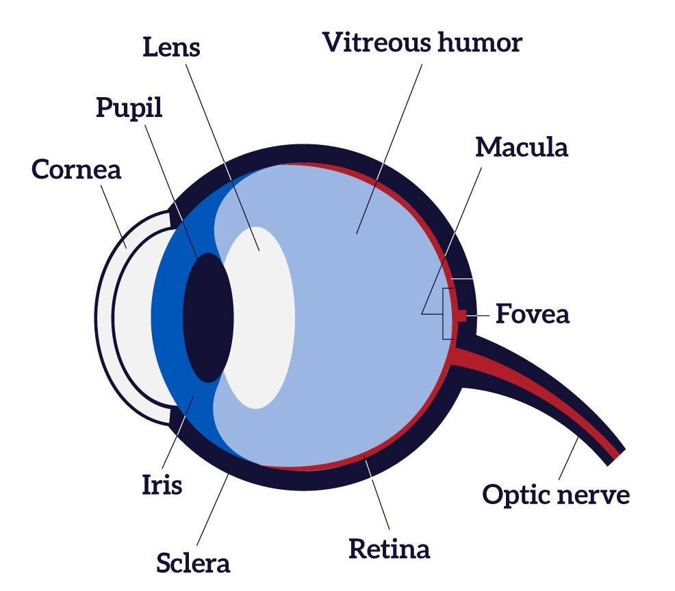
Learn what to look for and what you can do about it.
Notes:
The number of people with age related eye conditions and diseases will double by 2050.
Your vision changes as you age, but vision loss and blindness are not a normal part of aging.
Are you at risk for eye disease?
Getting older increases your risk of some eye diseases. You might also have a higher risk of some eye diseases if you:
Are overweight or obese
Have a family history of eye disease
Are African American, Hispanic, or Native American
Other health conditions, like diabetes or high blood pressure, can also increase your risk of some eye diseases. For example,
people with diabetes are at risk for Diabetic Retinopathy — an eye condition that can cause vision loss and blindness.
If you are worried you might be at risk for some eye diseases, talk to your doctor. You may be able to take steps to lower your risk. It is very important to know your family’s health history. Talk with your family members to find out if they have had any eye problems.
Some eye diseases and conditions run in families, like Age-related macular degeneration or Glaucoma. Be sure to tell your eye doctor if any eye diseases run in your family.

Slide 3
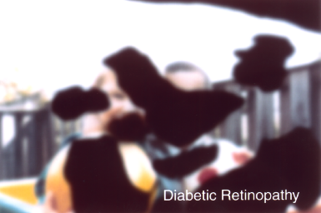
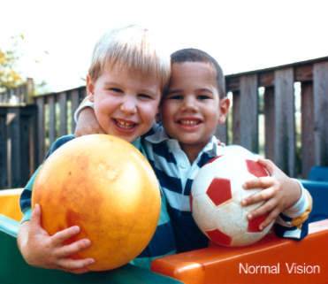
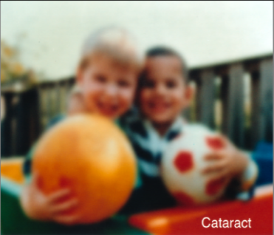
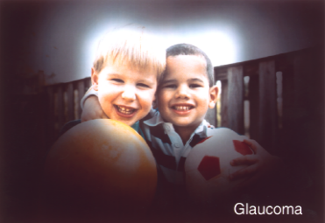
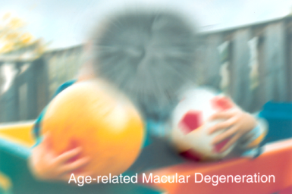
Common Conditions
Diabetic Retinopathy
This is unimpaired vision
Cataract
Age Related Macular Degeneration
Glaucoma
Notes:
Some chronic health issues have a higher likelihood of affecting your vision, and are all health concerns that warrant extra caution to keep your eyes healthy.
High blood pressure (Hypertension) - causes problems with your blood pressure can be linked to a host of health issues, including diabetes, heart disease, and obesity. Over time, the issues with your blood pressure can result in damage to the blood vessels in and around the eyes.
Lyme disease - Lyme disease can potentially result in eye infections that cause serious vision loss. In addition to conjunctivitis, the inflammation can also affect the middle portion of the eye (uveitis), the optic nerve, and even the blood vessels of the retinas.
Autoimmune conditions - There are many kinds of autoimmune diseases that can impact your vision. In many cases, problems with the eyes are among the first symptoms of autoimmune conditions. Early on, patients may experience red eyes, itchy eyes, or frequent dry eye. If the condition is undiagnosed or untreated, it’s possible for patients to experience eye pain, light sensitivity, changes to vision quality, and even vision loss.
Diabetes can drastically affect your vision. Diabetic Retinopathy is one issue that may be faced by all types of diabetics.
Glaucoma
The nerve connecting the eye to the brain is damaged, usually due to high eye pressure. The most common type often has no symptoms other than slow vision loss.
Age Related Macular Degeneration
This occurs with aging and happens because of a loss in the center of the field of vision. In dry macular degeneration, the center of the retina deteriorates. With wet macular degeneration, leaky blood vessels grow under the retina.
Cataract
Cataracts occur with a clouding of the normally clear lens of the eye. Most cataracts develop slowly over the course of years and are experienced with aging adults. The main symptom is blurry vision. Having diabetes makes you 2 to 5 times more likely to develop cataracts. Uncontrolled diabetes also makes you more likely to get them at a younger age.
Diabetic Retinopathy
If you have diabetes, it’s important to get a comprehensive dilated eye exam at least once a year. Diabetic retinopathy may not have any symptoms at first, but finding it early can help you take steps to protect your vision.
Managing your diabetes by staying physically active, eating healthy, and taking your medicine can also help you prevent or delay vision loss.
Things to look for include damage to the blood vessels in the tissue at the back of the eye (retina). Poorly controlled blood sugar is a risk factor. Early symptoms include floaters, blurriness, dark areas of vision, and difficulty perceiving colors. Can cause blindness.

Slide 4
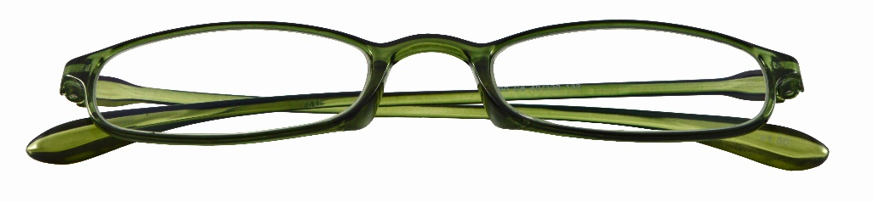
What to expect from your eyes as you age
Decrease in near vision
Change in color perception
Need for brighter light
Dry Eye Syndrome
Notes:
Your eyes change as you age. Eye problems can develop at any age though, so know what to look for.
Decrease in near vision
During their 40s, most people notice that seeing objects closer than 2 feet becomes difficult. This change in vision, called presbyopia, occurs because the lens of the eye stiffens. Normally, the lens changes its shape to help the eye focus. A stiffer lens makes focusing on close objects harder. Ultimately, almost everyone gets presbyopia and needs magnifying reading glasses. People who need glasses to see distant objects may need to wear bifocals or glasses with variable focus lenses.
Change in color perception
Cells in the retina that are responsible for normal color vision can decline in sensitivity as we age. Color will be less bright and the contrast between colors can be less noticeable. It may be challenging to distinguish colors, such as blue from black, or to see where an object ends and its background begins.
Need for brighter light
As we age, seeing in dim light becomes more difficult because the lens tends to become less transparent. A denser lens means less light passes through to the retina. On average, 60 year olds need three times more light to read than 20 year olds.
Dry Eye Syndrome
Dry eye is a condition that is extremely common as we age. Your body loses the ability to produce enough moisture. That includes the body is not producing enough tears for the eyes. When insufficient tears are produced, they evaporate more quickly leaving the eyes feeling dry and uncomfortable. Dry eyes can make working on the computer or reading very difficult. They can also lead to a stinging or burning sensation.
Dry eye syndrome is often treated with artificial eye drops that act as tears for the eyes, but your diet can also support more moisture for your eyes. Look for sources of Omega-3 fatty acids on page 18 of this booklet.

Slide 5
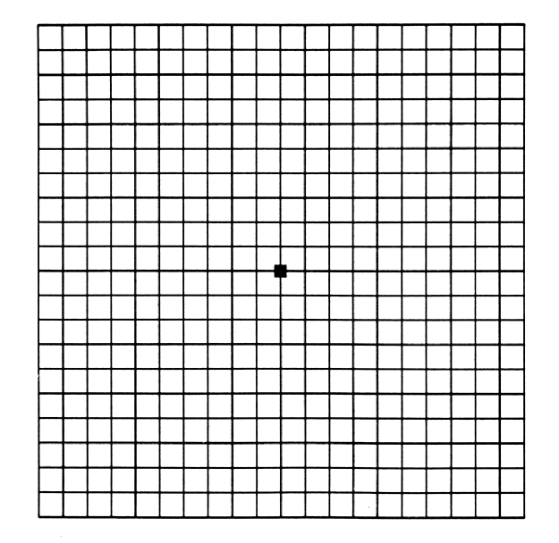
The Amsler grid
Notes:
Please note: If you have an urgent question about your eye health, contact your eye doctor immediately. This presentation is designed to provide general information about vision. It is not intended to provide medical advice. If you suspect that you have a vision problem or a condition that requires attention, consult with an eye care professional for advice on the treatment of your own specific condition and for your own particular needs.
The Amsler grid is a tool that eye doctors use to detect vision problems resulting from damage to the macula (the central part of the retina) or the optic nerve. If you are at risk for macular degeneration or other eye diseases, you can use this chart at home to monitor your vision. But using the chart doesn't mean you should skip regular visits to your eye doctor, because you can easily miss signs that only a trained eye care practitioner will find.
How to use the Amsler grid test
Test your eyes under normal room lighting used for reading.
Wear eyeglasses you normally wear for reading (even if you wear only store-bought reading glasses.
Hold the Amsler grid approximately 14 to 16 inches from your eyes.
Test each eye separately: Cup your hand over one eye while testing the other eye.
Keep your eye focused on the dot in the center of the grid and answer these questions:
Do any of the lines in the grid appear wavy, blurred or distorted?
Do all the boxes in the grid look square and the same size?
Are there any "holes" (missing areas) or dark areas in the grid?
Can you see all corners and sides of the grid (while keeping your eye on the central dot)?
Switch to the other eye and repeat.

Slide 6

Chronic health & Ocular health
High Blood Pressure
Diabetes
Lyme Disease
Autoimmune Diseases
Sickle Cell Disease
Rosacea
Liver Disease
Notes:
Some chronic health issues have a higher likelihood of affecting your vision,
Diabetes can drastically affect your vision. Diabetic retinopathy is an eye condition that can cause vision loss and blindness in people who have diabetes. Diabetic retinopathy is caused by high blood sugar due to diabetes. Over time, having too much sugar in your blood can damage your retina — the part of your eye that detects light and sends signals to your brain through the optic nerve in the back of your eye.
Problems with your blood pressure can be linked to a host of health issues, including diabetes, heart disease, and obesity. Over time, the issues with your blood pressure can result in damage to the blood vessels in and around the eyes.
Lyme disease can potentially result in eye infections that cause serious vision loss. In addition to conjunctivitis, the inflammation can also affect the middle portion of the eye (uveitis), the optic nerve, and even the blood vessels of the retinas.
Many kinds of autoimmune diseases can impact your vision. In many cases, problems with the eyes are among the first symptoms of autoimmune conditions. Early on, patients may experience red eyes, itchy eyes, or frequent dry eye. If the condition is undiagnosed or untreated, it’s possible for patients to experience eye pain, light sensitivity, changes to vision quality, and even vision loss.
Rosacea can affect vision. When the rosacea is located around the eyes, it can result in dry eye, itchiness, burning sensations, and redness of the eyes. The condition can also result in swelling of the eyelids and increased sensitivity to light.
Liver disease such as cirrhosis can lead to a number of eye problems, such as dry eye and itchiness of the eyes, as well as collections of fat on a person’s eyelids. Corneal damage and lens damage can occur if the condition goes untreated.
People who suffer from conditions that cause abnormally shaped blood cells run a number of health risks. For people with sickle cell disease, these abnormal blood cells can lead to damaged blood vessels in the eyes, eventually resulting in blindness if not dealt with in a timely manner.

Slide 7
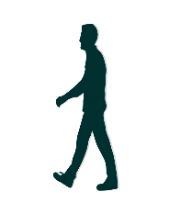
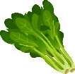
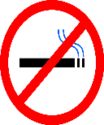
Take care of you
Know your health history and talk to your doctor about risk factors
Eat Well
Get Active
Quit Smoking
Notes:
The link between your overall health and your vision is strong. Work to lower your risk for conditions that can lead to eye problems.
Eat Well - Be sure to have plenty of dark, leafy greens like spinach, kale, and collard greens. Eating fish that are high in omega-3 fatty acids — like salmon, tuna, and halibut — is good for your eyes, too.
Get Active - Being physically active is the best way to stay healthy. It can also lower your risk of health conditions that can cause eye health or vision problems — like diabetes, high blood pressure, and high cholesterol.
Quit Smoking - Smoking isn’t just bad for your lungs — it can hurt your eyes, too! Smoking increases your risk of diseases like macular degeneration and cataracts — and it can harm the optic nerve.

Slide 8
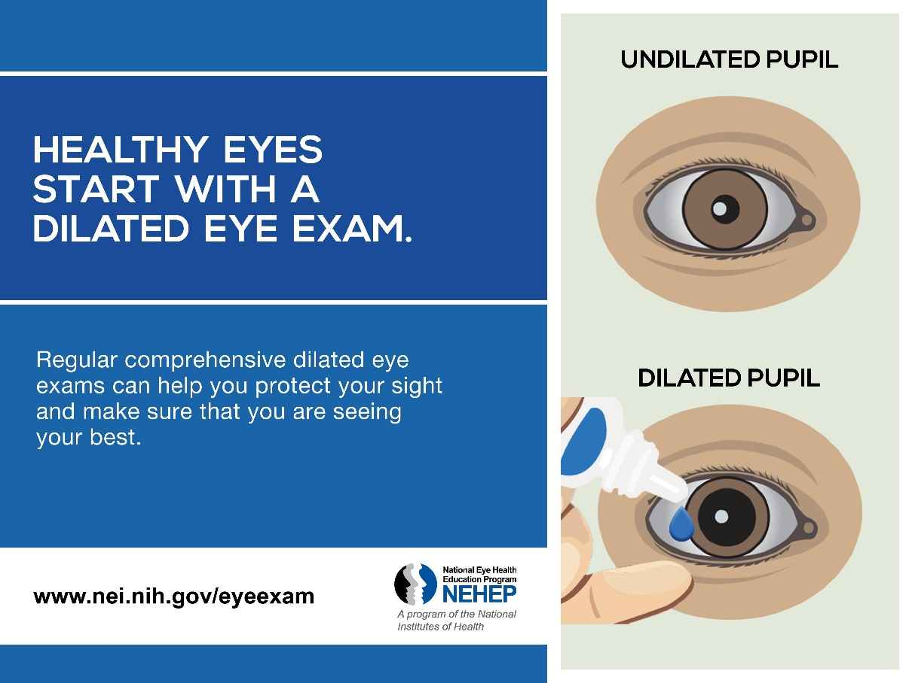
A dilated eye exam is the only way to check for many eye diseases early on, when they are easier to treat.
Dilated eye exam
Notes:
Getting a dilated eye exam is simple and painless — and it is the single best thing you can do for your eye health! Even if your eyes feel healthy, you could have a problem and not know it. That’s because many eye diseases don’t have any symptoms or warning signs. A dilated eye exam is the only way to check for many eye diseases early on, when they are easier to treat.
Opticians are technicians who fit eyeglasses, contact lenses, and other vision-correcting devices. Optometrists examine, diagnose, and treat patients’ eyes. Ophthalmologists are eye doctors who perform medical and surgical treatments for eye conditions.
How often you need a dilated eye exam depends on your risk for eye disease. Talk to your doctor about what is right for you. Most people with diabetes or high blood pressure need to get a dilated eye exam at least once a year
During the exam your doctor will give you some eye drops to dilate (widen) your pupil. This helps the doctor see inside your eye and check for problems with the inner parts of your eye. Dilating your pupil lets more light into your eye, like opening a door lets light into a dark room.
How to schedule an appointment / OHB can provide information.
Health Plans - Visit dhrm.virginia.gov and select State Employees from the menu. Next choose Benefits, State Health Benefits, Active Employees, Plan Choices, and your plan name.

Slide 9
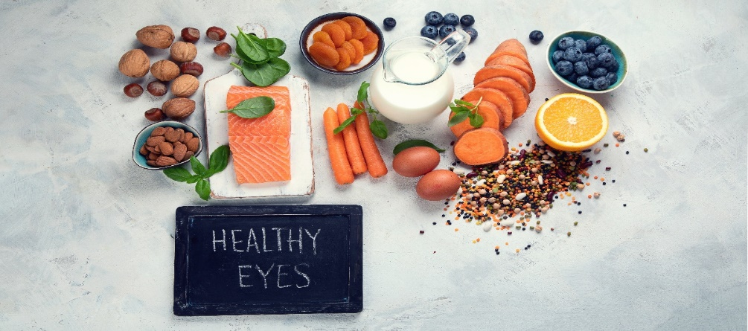
Food
and your eyes
Dark leafy greens, sweet potatoes, oranges, whole grains, and healthy fatty fish are all parts of an eye conscious diet.
Notes:
If you took inventory on foods you normally eat, would you say your eyes have all the nutrients they need to help prevent cataracts, macular degeneration, glaucoma and other vision woes? Did you know that eating healthy foods could help protect your eyesight?
Foods with vitamins C and E, zinc, lutein, zeaxanthin, and omega-3 fatty acids are linked to lower risk for age-related macular degeneration, cataract and perhaps even dry eye.
Dark leafy greens, sweet potatoes, oranges, whole grains, and healthy fatty fish are all parts of an eye conscious diet.
Fruits and vegetables are some of the best foods for eye health because they are full of antioxidants. Put simply, antioxidants are foods that keep us healthy by delaying or slowing down oxidation, which causes cell damage and cell aging. Regularly enjoying a piece of fruit and a side of vegetables can help decrease your chance of developing cataracts and other vision problems.
While you can get supplements in pill form at your local pharmacy, antioxidants are most beneficial when consumed from fruits and vegetables and other whole foods. Studies using supplements have not shown the same successful results in preventing eye-related problems. Antioxidant supplements also have not been shown to help prevent cataracts.
So load up on vegetables and delicious fruits! Fresh and frozen are great choices, but canned vegetables that are low in sodium are a good choice too. You will be doing your eyes and your health a favor.

Slide 10





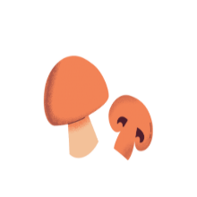
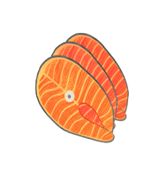

Lutein & Zeaxanthin
Protects eyes from sun damage & aging
Leafy greens, broccoli, peas, kiwi,
red grapes, yellow squash (eat with healthy fats)
Zinc
Keeps the eye’s tissue healthy
Lean meat, seafood, eggs, cheese, soybeans, peanuts, bran, wheat germ
Beta-carotene & Vitamin A
Prevents dry eyes and night blindness
Sweet potatoes, carrots, butternut
squash, dark leafy greens, liver, milk, eggs
Thiamin
Decreased risk of cataract and glaucoma
Enriched and fortified whole grains,
eggs, pork, legumes, seeds, nuts
Vitamin C
Lowers risk of cataracts
Strawberries, bell peppers,
oranges, kiwi, grapefruit, cantaloupe
Vitamin D
Prevention of macular degeneration
Fresh fish, eggs, mushrooms,
milk, yogurt, fortified cereal, pork
Omega-3 Fatty Acids
Lowers risk for high eye pressure/glaucoma
Salmon, sardines, trout, walnuts,
flaxseed, chia seeds
Vitamin E
Prevention of macular degeneration
Walnuts, almonds, pistachios, sunflower seeds,
dark leafy greens, pumpkin, peanuts
Notes:
Let’s go over some specific foods you can add to your diet that provide more eye healthy nutrients!
Lutein & Zeaxanthin - Protects eyes from sun damage & aging
Enjoy eating leafy greens, broccoli, peas, kiwi, red grapes, and yellow squash (eat with healthy fats)
Beta-carotene & Vitamin A - Prevents dry eyes and night blindness
Include sweet potatoes, carrots, butternut, squash, dark leafy greens, liver, milk, and eggs
Vitamin C - Lowers risk of cataracts
Enjoy juicy strawberries, bell peppers, oranges, kiwi, grapefruit, and cantaloupe
Omega-3 Fatty Acids - Lowers risk for high eye pressure/glaucoma
You’ll find theses in salmon, sardines, trout, walnuts, flaxseed, and chia seeds
Zinc - Keeps the eye’s tissue healthy
Eat lean meat, seafood, eggs, cheese, soybeans, peanuts, bran, and wheat germ
Thiamin - Decreased risk of cataract and glaucoma
Enjoy eating enriched and fortified whole grains, eggs, pork, legumes, seeds, and nuts
Vitamin D - Prevention of macular degeneration
Include fresh fish, eggs, mushrooms, milk, yogurt, fortified cereal, and lean cuts of pork
Vitamin E - Prevention of macular degeneration
Eat more walnuts, almonds, pistachios, sunflower seeds, dark leafy greens, pumpkin, and peanuts

Slide 11
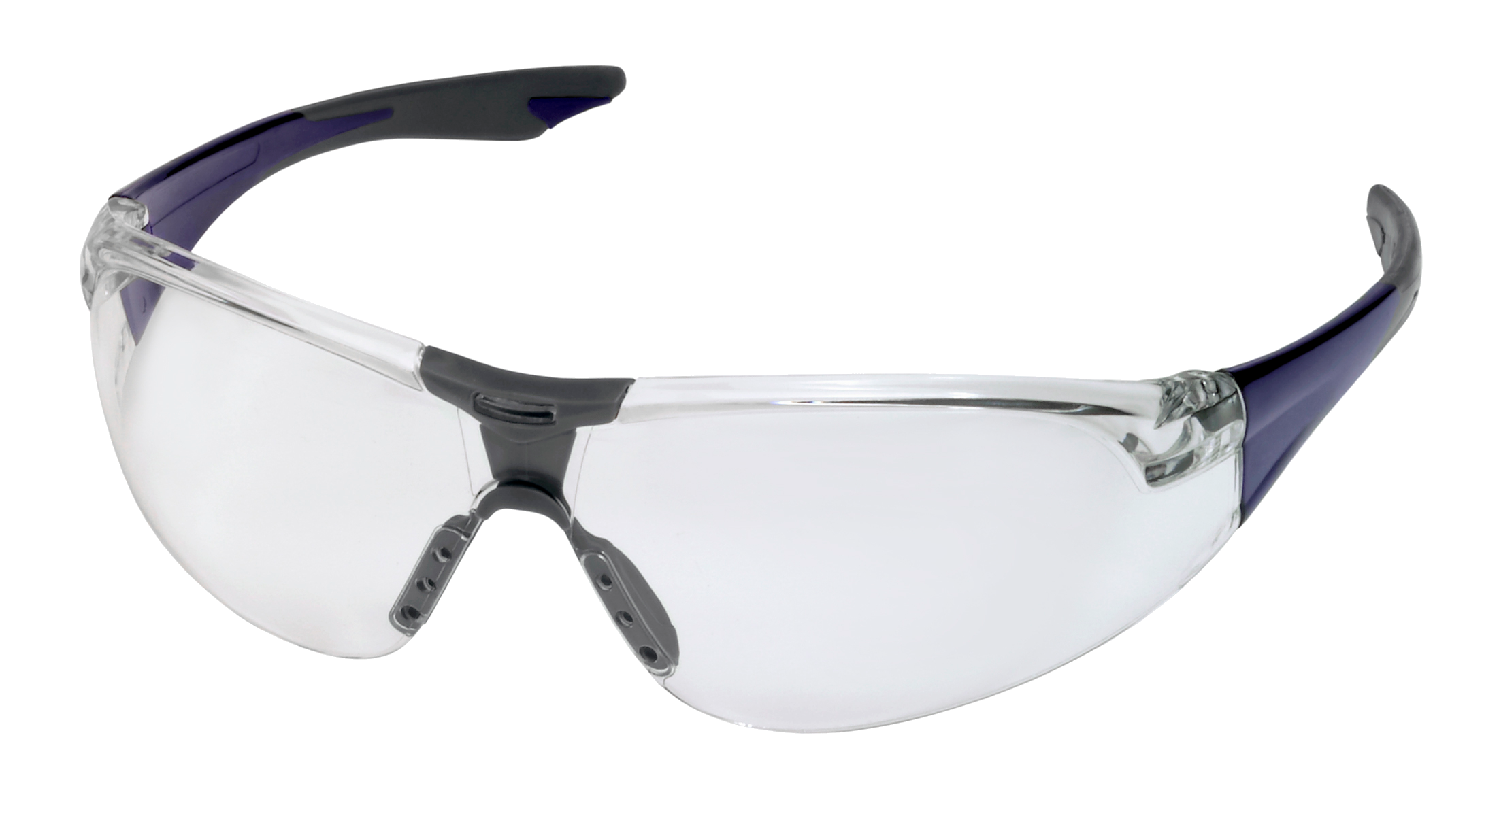
Safety
Glasses
Safety experts and medical professionals believe that 90% of all eye injuries are preventable by wearing appropriate safety eyewear.
Notes:
You should wear safety eyewear because they are the best defense against eye injuries. They protect your eyes from a myriad of potential hazards at work, home and outdoors. Comprehensively, safety eyewear saves businesses and workers a tremendous amount of time and money. Also, wearing safety eyewear can have a significant impact on overall, long-term eye health.
An approximate 125,000 eye injuries happen in the home every year, and over 40,000 sports-related eye injuries take place yearly.
While the numbers are startling, even more eye-catching is that eye injuries are the most preventable cause of blindness. Diseases like glaucoma and macular degeneration don’t cause as many cases of blindness as eye injuries.
Safety experts and medical professionals believe that 90% of all eye injuries are preventable by wearing appropriate safety eyewear.
Protective eyewear includes safety glasses, goggles, face shields and side shields designed for specific activities. Common hazards include chemicals, corneal flash burns, pollen, dust, and the blunt force of large objects.
A big key in safety eyewear protecting eyes against hazards involves taking all the potential dangers of a situation into account and wearing the appropriate eyewear.
Accidents can happen anywhere, so protect your eyes at work, home and during recreations.
In the workplace, this means having and following recommendations of safety experts at OSHA as well as performing regular safety audits.
At home, it involves at a minimum wearing standard safety eyewear for yard work, house cleaning and whenever working with power tools.
During recreation, it means using what experts recommend for specific activities.
Though hazards sometimes present themselves unexpectedly, a person can be sufficiently equipped when they are most likely to occur.

Slide 12

Eye Q & A
Every 20 minutes, take a 20-second break and look 20 feet into the distance. Your eyes can rest, refocus, and rehydrate as you blink.
Notes:
QUESTION: How can I address eye strain from computer work?
Follow the 20-20-20 rule. We don’t blink as much during near-task activities. Dry eyes can be painful and can, in severe cases, lead to scars or ulcers on the cornea or loss of vision. Try the 20-20-20 rule: Every 20 minutes, take a 20-second break and look 20 feet into the distance. Your eyes can rest, refocus, and rehydrate with some much-needed blinks.
You can also try blue blocking computer glasses. Blue light blocking glasses can help reduce eye strain. Blue light can make it difficult to focus on the screen, making your eyes strain to concentrate. Blue light glasses help increase contrast on your screen, making it easier to focus and subsequently reduce eye strain.

Slide 13
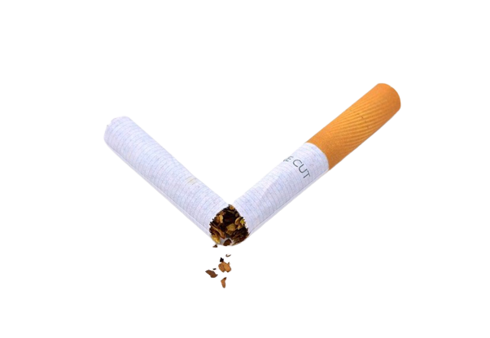
Eye Q & A
QUESTION: Do I wash my hands before or after touching my contacts? Both. Up to 90 percent of wearers don’t correctly care for their lenses, according to the CDC. This often results in keratitis, a treatable inflammation of the cornea. Take care: Wash your hands before and after you touch your eyes, and clean your lens case with hot water weekly. If your eyes are red and irritated, wear glasses to give your eyes a break.
Quitting smoking at any age, even later in life, can significantly reduce your risk age-related macular degeneration, cataracts, glaucoma , diabetic retinopathy and
Dry Eye Syndrome.
QUESTION: Should I blink a lot to get an irritant out of my eyes? No. When soap or another irritant gets in your eyes, use water, not tears, to flush the substance out, especially if it’s an alkaline solution (like toothpaste) or a cleaning product (like bleach). Tears can’t flush away irritants as quickly or as thoroughly as water can. Hold your face under a running faucet or shower, or pour water onto your eye from a clean cup repeatedly for 15 minutes. If it still stings, call an eye doctor.
Notes:
QUESTION: Why is smoking such a big deal for my eyes?
Smokers are up to four times more likely to go blind in old age. Studies show smoking increases the risk of age-related macular degeneration, cataracts, glaucoma and diabetic retinopathy and Dry Eye Syndrome. The good news is that quitting smoking at any age, even later in life, can significantly reduce your risk of developing these conditions. Call Quit Now Virginia (1.800.Quit.Now).

Slide 14
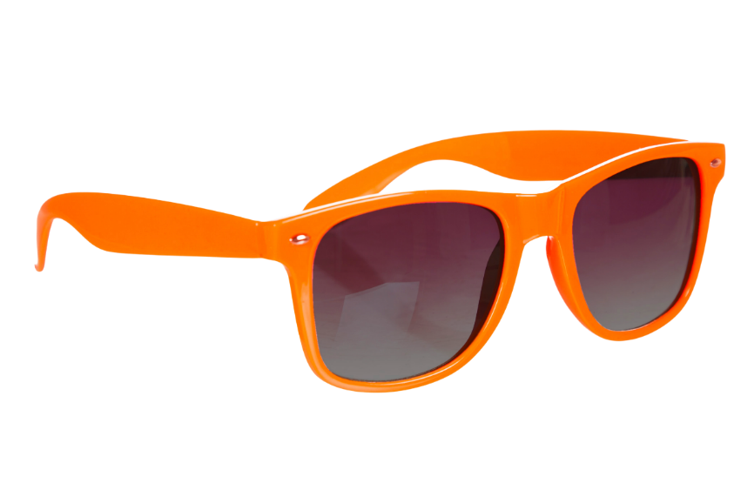
Eye Q & A
QUESTION: Do I wash my hands before or after touching my contacts? Both. Up to 90 percent of wearers don’t correctly care for their lenses, according to the CDC. This often results in keratitis, a treatable inflammation of the cornea. Take care: Wash your hands before and after you touch your eyes, and clean your lens case with hot water weekly. If your eyes are red and irritated, wear glasses to give your eyes a break.
Over time, UV exposure can put you at higher risk for cataracts, thickening of the eye tissue, and skin cancer around the eyes. Lenses with UVA and UVB coatings will reduce those risks.
QUESTION: Should I blink a lot to get an irritant out of my eyes? No. When soap or another irritant gets in your eyes, use water, not tears, to flush the substance out, especially if it’s an alkaline solution (like toothpaste) or a cleaning product (like bleach). Tears can’t flush away irritants as quickly or as thoroughly as water can. Hold your face under a running faucet or shower, or pour water onto your eye from a clean cup repeatedly for 15 minutes. If it still stings, call an eye doctor.
Notes:
QUESTION: Do sunglasses really protect my eyes? Yes. Believe it or not, even your eyes can get “sunburned.” Just as UV damage accumulates on skin over a lifetime, this also happens to the eyes. Over time, UV exposure can put you at higher risk for cataracts, thickening of the eye tissue, and skin cancer around the eyes. Lenses with UVA and UVB coatings will reduce those risks. (Polarized lenses reduce glare but don’t offer much additional sight protection.)
QUESTION: Does the tint of my lenses matter? It can. Copper, orange, yellow/amber, and brown lens tints are helpful in low-light conditions because they make an environment appear brighter. They also enhance contrast and depth perception. Additionally, these lens tints block blue light. Blue light scatters easier than other colors and makes focusing on objects difficult. Removing blue light improves sharpness and depth perception and reduces eye fatigue.

Slide 15
Eye Action Plan
Get a Dilated Exam
Know What to Look For
Eat Well for Eye Health
Protect Your Eyes
Notes:
These are the best steps you can take for your eye action plan.
Get a Dilated Exam
A dilated eye exam is the only way to check for many eye diseases early on, when they are easier to treat. Track changes in your vision by making sure you’ve had a complete exam around age 40.
Know What to Look For
Learn what conditions to watch out for by knowing your family history, what is normal and what isn’t, and self-monitoring by using the Amsler grid.
Eat Well for Eye Health
Some foods are especially beneficial at helping our vision. Focus on fruits, vegetables, lean meats and fish, and nuts and seeds as part of your balanced diet to support your vision.
Protect Your Eyes
Safety eyewear and sunglasses are the best defense against eye injuries and sun damage. They protect your eyes from a myriad of potential hazards at work, home, and outdoors.

Slide 16
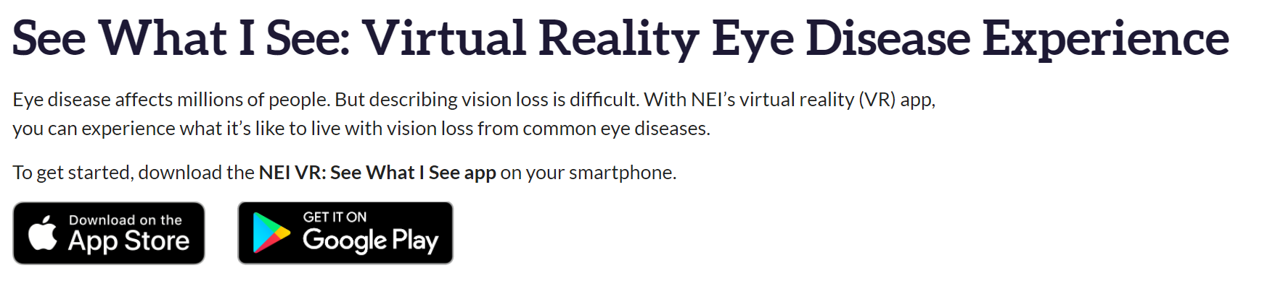
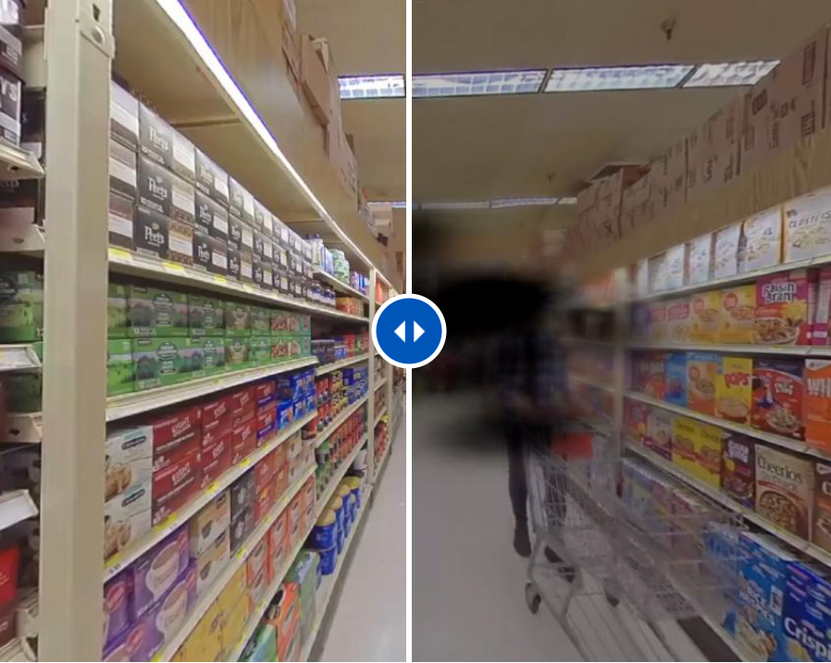
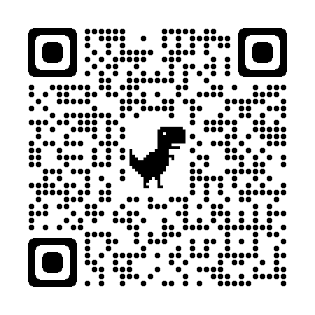
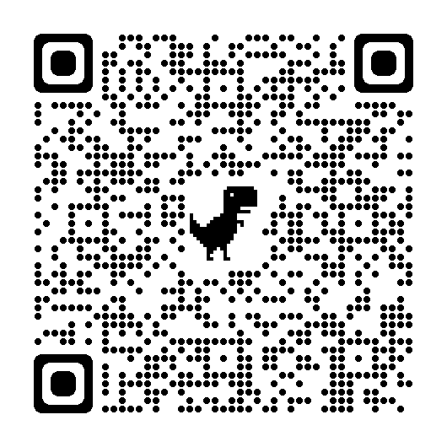
VR
VR Experience
NEI VR: See What I See
Notes:
OR SLIDE 4 position
This is an APP that people can download on their phones to see what the various conditions feel like.
This can be used as an activity in a longer program.

Slide 17

CommonHealth.Virginia.Gov
Notes:
Questions? Thank you for participating in CommonHealth! Here are some more resources to help.
Resources
Health Plans
Visit dhrm.virginia.gov and select State Employees from the menu. Next choose Benefits, State Health Benefits, Active Employees, Plan Choices, and your plan name.
Eye Health
National Eye Institute - nei.nih.gov/
Family Health History Tool – xxx.xxxxx
Recipes for Better Vision
eatingwell.com
fruitsandveggies.org
WW recipes?
Eye Protection
osha.gov/eye-face-protection

